Slide 1
Variational Inference
Il-Chul Moon Dept. of Industrial and Systems Engineering KAIST
icmoon@kaist.ac.kr

Slide 2
Variational approximation

Slide 3
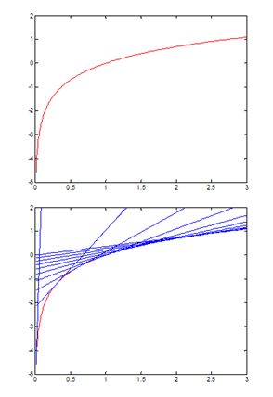
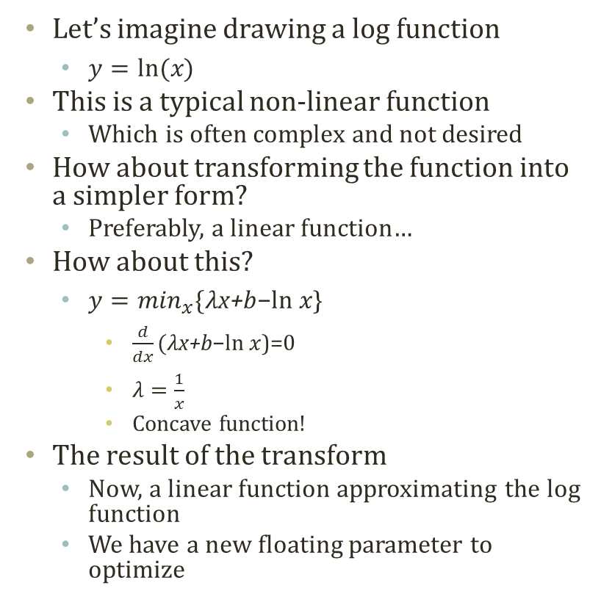
Variational Transform
Let’s imagine drawing a log function
$y=ln⁡(x)$
This is a typical non-linear function
Which is often complex and not desired
How about transforming the function into a simpler form?
Preferably, a linear function…
How about this?
$y=\min_{x}\{λ\text{x}\text{+}\text{b}\text{−}\text{ln} x\text{\}}$
$\frac{d}{dx}(λ\text{x}\text{+}\text{b}\text{−}\text{ln} x\text{)=0}$
$λ=\frac{1}{x}$
Concave function!
The result of the transform
Now, a linear function approximating the log function
We have a new floating parameter to optimize

Slide 4
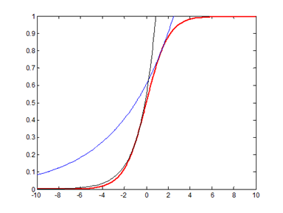
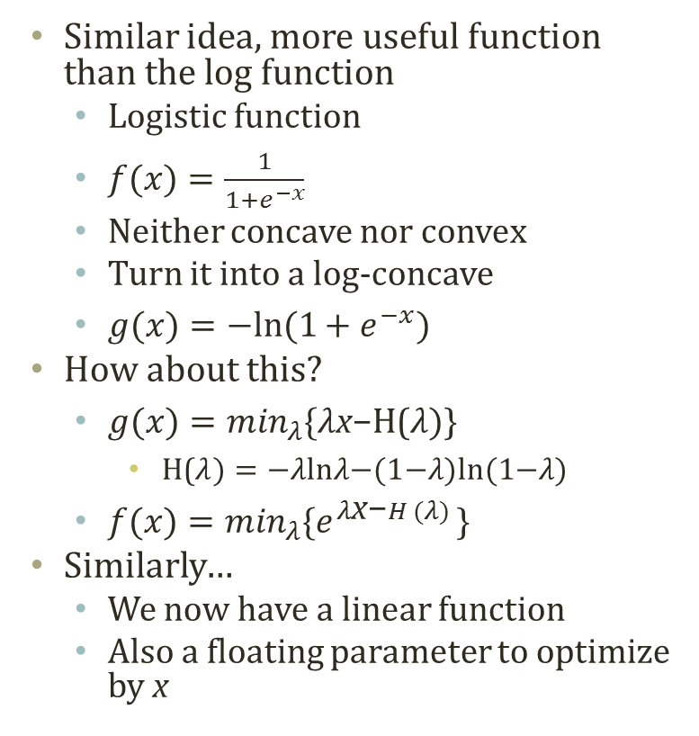
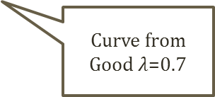
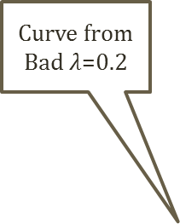
Variational Transform on Logistic Function
Similar idea, more useful function than the log function
Logistic function
$f(x)=\frac{1}{1+e^{−x}}$
Neither concave nor convex
Turn it into a log-concave
$g(x)=−ln⁡(1+e^{−x})$
How about this?
$g(x)=\min_{λ}\{λ\text{x}\text{−}\text{H}\text{(}λ)\text{\}}$
$\text{H}\text{(}λ)=\text{−}λ\text{ln}λ\text{−(1−}λ\text{)}\text{ln}\text{(1−}λ\text{)}$
$f(x)=\min_{λ}\{e^{λ\text{x}\text{−}H (λ) }\text{\}}$
Similarly…
We now have a linear function
Also a floating parameter to optimize by x
When approximating a certain f(x) with a fixed x
Curve from Bad $λ$=0.2
Curve from Good $λ$=0.7

Slide 5
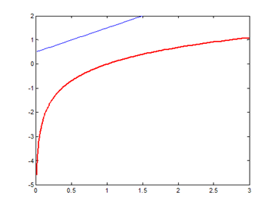
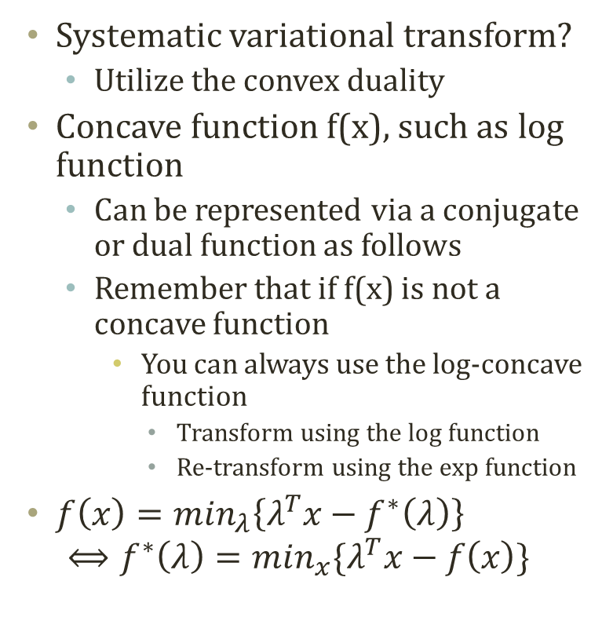

Convex Duality
Systematic variational transform?
Utilize the convex duality
Concave function f(x), such as log function
Can be represented via a conjugate or dual function as follows
Remember that if f(x) is not a concave function
You can always use the log-concave function
Transform using the log function
Re-transform using the exp function
$f\left(x\right)=\min_{λ}\left\{λ^{T}x−f^{∗}\left(λ\right)\right\}$ $⟺f^{∗}\left(λ\right)=\min_{x}\{λ^{T}x−f\left(x\right)\}$
Minimization, or optimization, through finding the tangent line
Use derivatives…
$$\frac{d}{dx}\left(λx−lnx\right)=0 \\ λ=\frac{1}{x} \\ ⇒λx−lnx=λ\frac{1}{λ}−ln\frac{1}{λ}=1+lnλ$$
Dual function or Conjugate function

Slide 6

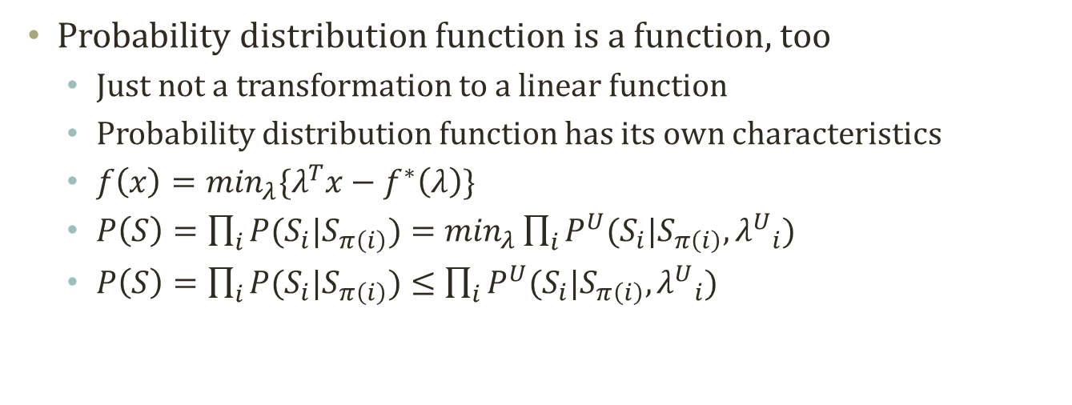
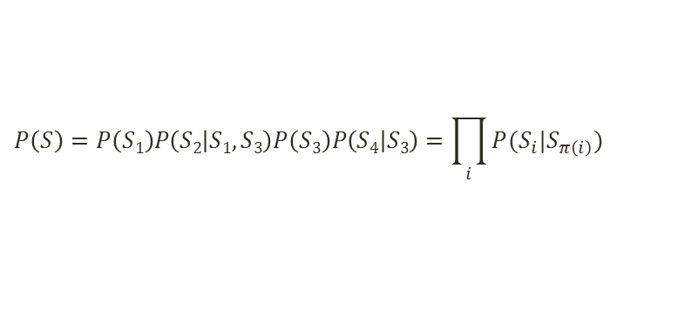
Applying to Probability Function
Probability distribution function is a function, too
Just not a transformation to a linear function
Probability distribution function has its own characteristics
$f\left(x\right)=\min_{λ}\{λ^{T}x−f^{∗}\left(λ\right)\}$
$P\left(S\right)=\prod_{i}{P(S_{i}|S_{π\left(i\right)})}=\min_{λ}\prod_{i}{P^{U}(S_{i}|S_{π\left(i\right)}, {λ^{U}}_{i})}$
$P\left(S\right)=\prod_{i}{P(S_{i}|S_{π\left(i\right)})}≤\prod_{i}{P^{U}(S_{i}|S_{π\left(i\right)}, {λ^{U}}_{i})}$
S₁
S₃
Parent nodes:
$$π\left(2\right)=\{1,3\}$$
S₂
S₄
$$P\left(S\right)=P\left(S1\right)P\left(S2 | S1,S3\right)P\left(S3\right)P\left(S4 | S3\right)=\prod_{i}{P(S_{i}|S_{π\left(i\right)})}$$

Slide 7
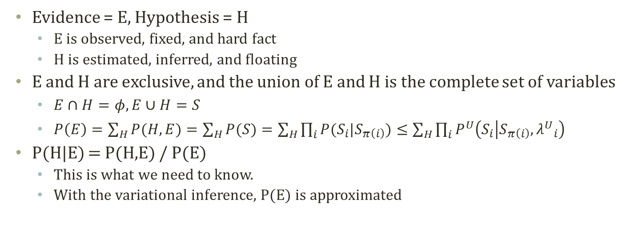
Variables of E and H
Evidence = E, Hypothesis = H
E is observed, fixed, and hard fact
H is estimated, inferred, and floating
E and H are exclusive, and the union of E and H is the complete set of variables
$E∩H=φ, E∪H=S$
$P\left(E\right)=\sum_{H}{P(H,E)}=\sum_{H}{P(S)}=\sum_{H}{\prod_{i}{P(S_{i}|S_{π\left(i\right)})}}≤\sum_{H}{\prod_{i}{P^{U}\left(S_{i} | S_{π\left(i\right)}, {λ^{U}}_{i}\right)}}$
P(H|E) = P(H,E) / P(E)
This is what we need to know.
With the variational inference, P(E) is approximated
S₁
S₃
Variables to Infer
S₂
S₄
Variables to Observe

Slide 8
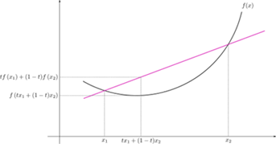
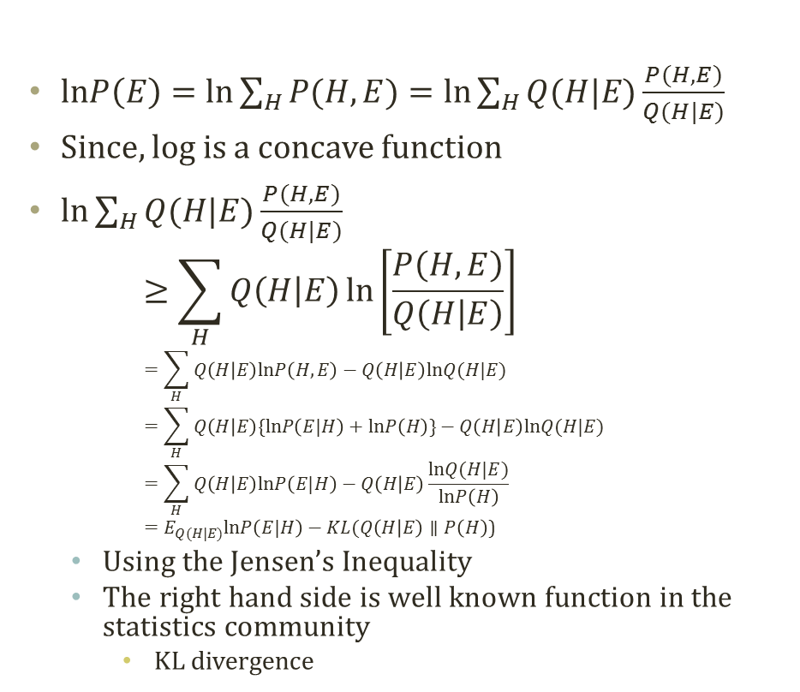
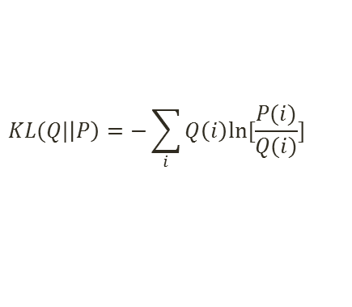
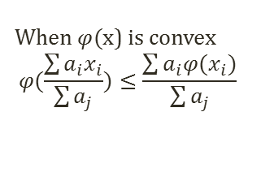
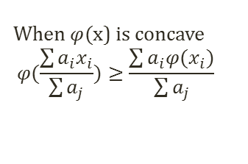
Setting the Minimum Criteria
$lnP\left(E\right)=ln\sum_{H}{P(H,E)}=ln\sum_{H}{Q(H|E)\frac{P(H,E)}{Q(H|E)}}$
Since, log is a concave function
$ln\sum_{H}{Q(H|E)\frac{P(H,E)}{Q(H|E)}}$ $≥\sum_{H}{Q\left(H | E\right)\ln\left[\frac{P\left(H,E\right)}{Q\left(H | E\right)}\right]}$ $=\sum_{H}{Q\left(H | E\right)lnP\left(H,E\right)−Q\left(H | E\right)lnQ(H|E) }$ $=\sum_{H}{Q\left(H | E\right)\{lnP\left(E|H\right)+lnP\left(H\right)\}−Q\left(H | E\right)lnQ(H|E) }$ $=\sum_{H}{Q\left(H | E\right)lnP\left(E|H\right)−Q\left(H | E\right)\frac{lnQ(H|E)}{lnP\left(H\right)} }$ $=E_{Q(H|E)}lnP\left(E|H\right)−KL(Q\left(H | E\right)∥P\left(H\right)\text{)}$
Using the Jensen’s Inequality
The right hand side is well known function in the statistics community
KL divergence
Jensen’s Inequality
©Wikipedia
When $φ($x) is concave
$$φ(\frac{\sum{a_{i}x_{i}}}{\sum{a_{j}}})≥\frac{\sum{a_{i}φ(x_{i}})}{\sum{a_{j}}}$$
When $φ($x) is convex
$$φ(\frac{\sum{a_{i}x_{i}}}{\sum{a_{j}}})≤\frac{\sum{a_{i}φ(x_{i}})}{\sum{a_{j}}}$$
$$KL(Q|\left|P\right)=−\sum_{i}{Q\left(i\right)ln[\frac{P(i)}{Q(i)}]}$$
Minimizing KL Divergence → Finding the true lnP(E)

Slide 9
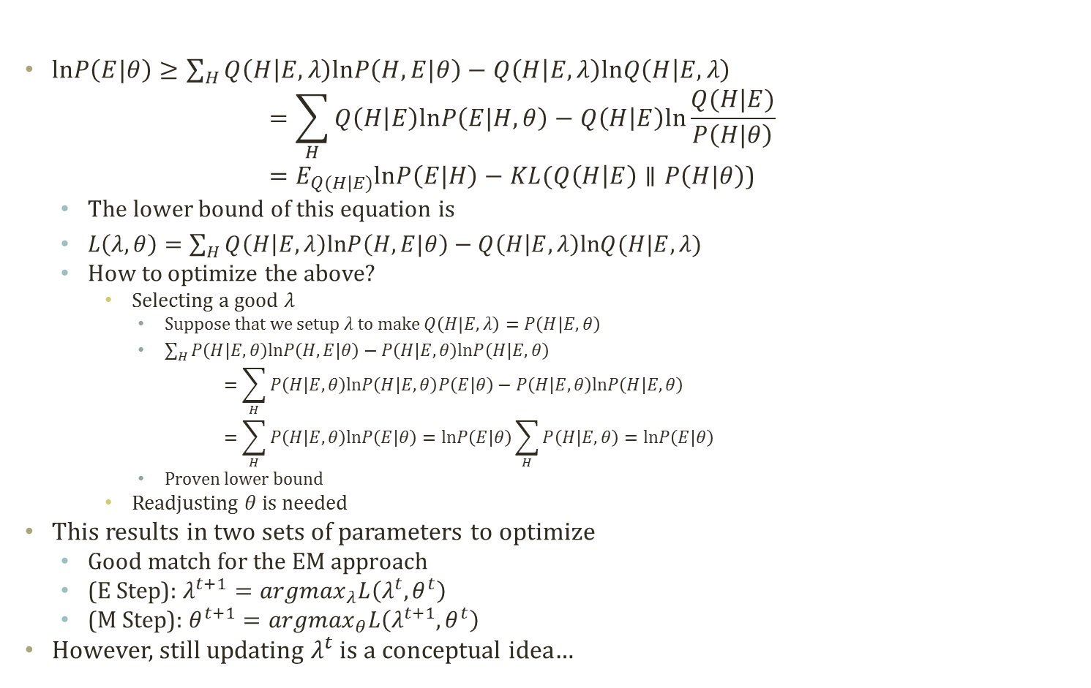
Optimizing the Lower Bound
$lnP\left(E|θ\right)≥\sum_{H}{Q\left(H | E,λ\right)lnP\left(H,E|θ\right)−Q\left(H | E,λ\right)lnQ\left(H | E,λ\right)}$ $=\sum_{H}{Q\left(H | E\right)lnP\left(E|H,θ\right)−Q\left(H | E\right)ln\frac{Q(H|E)}{P\left(H|θ\right)} }$ $=E_{Q(H|E)}lnP\left(E|H\right)−KL(Q\left(H | E\right)∥P\left(H|θ\right)\text{)}$
The lower bound of this equation is
$L\left(λ,θ\right)=\sum_{H}{Q\left(H | E,λ\right)lnP\left(H,E|θ\right)−Q\left(H | E,λ\right)lnQ(H|E,λ) }$
How to optimize the above?
Selecting a good $λ$
Suppose that we setup $λ$to make $Q\left(H | E,λ\right)=P\left(H|E,θ\right)$
$\sum_{H}{P\left(H|E,θ\right)lnP\left(H,E|θ\right)−P\left(H|E,θ\right)lnP\left(H|E,θ\right)}$ $=\sum_{H}{P\left(H|E,θ\right)lnP\left(H|E,θ\right)P\left(E|θ\right)−P\left(H|E,θ\right)lnP\left(H|E,θ\right)}$ $=\sum_{H}{P\left(H|E,θ\right)lnP\left(E|θ\right)}=lnP\left(E|θ\right)\sum_{H}{P\left(H|E,θ\right)}=lnP\left(E|θ\right)$
Proven lower bound
Readjusting $θ$ is needed
This results in two sets of parameters to optimize
Good match for the EM approach
(E Step): $λ^{t+1}={argmax}_{λ}L\left(λ^{t},θ^{t}\right)$
(M Step): $θ^{t+1}={argmax}_{θ}L\left(λ^{t+1},θ^{t}\right)$
However, still updating $λ^{t}$ is a conceptual idea…

Slide 10

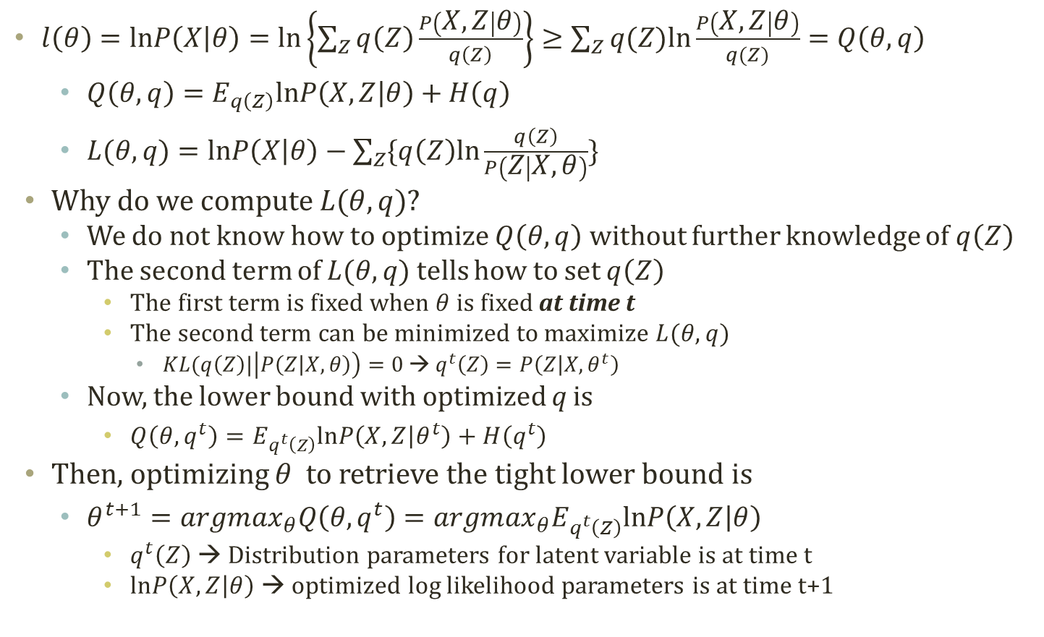

Detour: Maximizing the Lower Bound in GMM
$l\left(θ\right)=lnP\left(X | θ\right)=ln\left\{\sum_{Z}{q\left(Z\right)\frac{P\left(X,Z | θ\right)}{q\left(Z\right)}}\right\}≥\sum_{Z}{q(Z)ln\frac{P\left(X,Z | θ\right)}{q(Z)}}=Q\left(θ,q\right)$
$Q\left(θ,q\right)=E_{q\left(Z\right)}lnP\left(X,Z | θ\right)+H\left(q\right)$
$L(θ,q)=lnP\left(X | θ\right)−\sum_{Z}{\{q\left(Z\right)ln\frac{q\left(Z\right)}{P\left(Z | X,θ\right)}\}}$
Why do we compute $L(θ,q)$?
We do not know how to optimize $Q\left(θ,q\right)$ without further knowledge of $q\left(Z\right)$
The second term of $L(θ,q)$ tells how to set $q\left(Z\right)$
The first term is fixed when $θ$ is fixed at time t
The second term can be minimized to maximize $L(θ,q)$
$KL(q\left(Z\right)|\left|P\left(Z | X,θ\right)\right)=0$ → $q^{t}\left(Z\right)=P\left(Z | X, θ^{t}\right)$
Now, the lower bound with optimized q is
$Q\left(θ,q^{t}\right)=E_{q^{t}\left(Z\right)}lnP\left(X,Z | θ^{t}\right)+H\left(q^{t}\right)$
Then, optimizing $θ$ to retrieve the tight lower bound is
$θ^{t+1}={argmax}_{θ}Q\left(θ,q^{t}\right)={argmax}_{θ}E_{q^{t}\left(Z\right)}lnP\left(X,Z | θ\right)$
$q^{t}\left(Z\right)$ → Distribution parameters for latent variable is at time t
$lnP\left(X,Z | θ\right)$ → optimized log likelihood parameters is at time t+1
Tells how to setup Z
by setting $q^{t}\left(Z\right)=P\left(Z | X, θ^{t}\right)$
Relax the KL divergence by updating $θ^{t}$ to $θ^{t+1}$

Slide 11
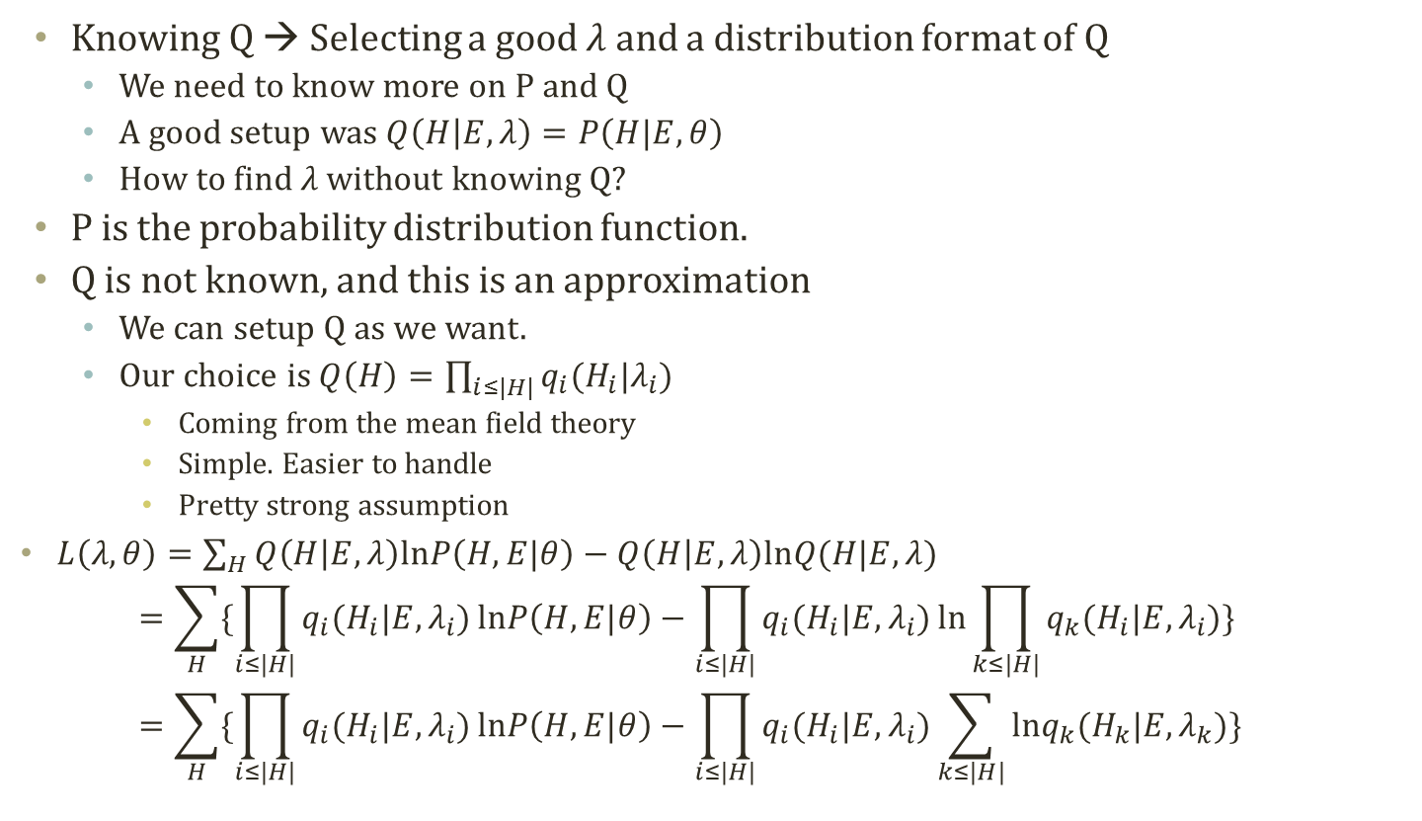
Factorizing Q
Knowing Q → Selecting a good 𝜆 and a distribution format of Q
We need to know more on P and Q
A good setup was $Q\left(H | E,λ\right)=P\left(H|E,θ\right)$
How to find 𝜆 without knowing Q?
P is the probability distribution function.
Q is not known, and this is an approximation
We can setup Q as we want.
Our choice is $Q\left(H\right)=\prod_{i≤|H|}{q_{i}(H_{i}|λ_{i})}$
Coming from the mean field theory
Simple. Easier to handle
Pretty strong assumption
$L\left(λ,θ\right)=\sum_{H}{Q\left(H | E,λ\right)lnP\left(H,E|θ\right)−Q\left(H | E,λ\right)lnQ(H|E,λ) }$ $=\sum_{H}{\{\prod_{i≤|H|}{q_{i}(H_{i}|E,λ_{i})}lnP\left(H,E|θ\right)−\prod_{i≤|H|}{q_{i}(H_{i}|E,λ_{i})}ln\prod_{k≤|H|}{q_{k}(H_{i}|E,λ_{i})}}\}$ $=\sum_{H}{\{\prod_{i≤|H|}{q_{i}(H_{i}|E,λ_{i})}lnP\left(H,E|θ\right)−\prod_{i≤|H|}{q_{i}(H_{i}|E,λ_{i})}\sum_{k≤|H|}{lnq_{k}(H_{k}|E,λ_{k})}}\}$

Slide 12
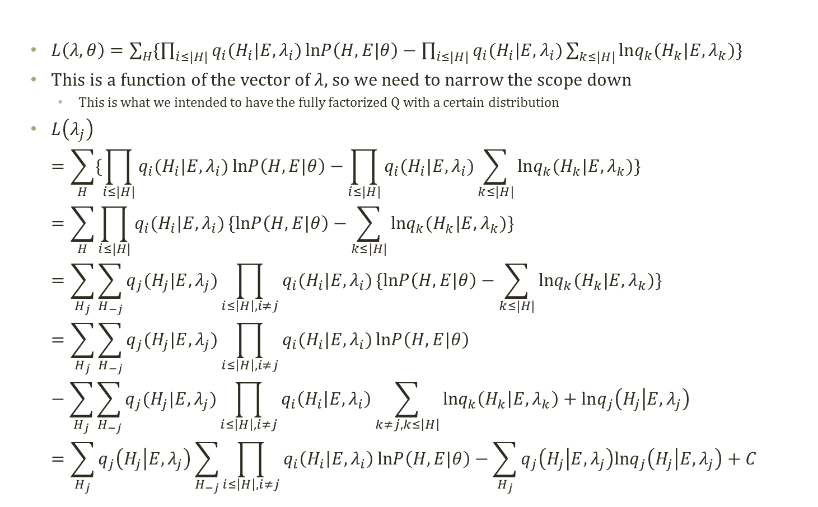
Focusing on Single Variable in Q
$L\left(λ,θ\right)=\sum_{H}{\{\prod_{i≤|H|}{q_{i}(H_{i}|E,λ_{i})}lnP\left(H,E|θ\right)−\prod_{i≤|H|}{q_{i}(H_{i}|E,λ_{i})\sum_{k≤|H|}{lnq_{k}(H_{k}|E,λ_{k})}}}\}$
This is a function of the vector of $λ$, so we need to narrow the scope down
This is what we intended to have the fully factorized Q with a certain distribution
$L\left(λ_{j}\right)$ $=\sum_{H}{\{\prod_{i≤|H|}{q_{i}(H_{i}|E,λ_{i})}lnP\left(H,E|θ\right)−\prod_{i≤|H|}{q_{i}(H_{i}|E,λ_{i})}\sum_{k≤|H|}{lnq_{k}(H_{k}|E,λ_{k})}}\}=\sum_{H}{\prod_{i≤|H|}{q_{i}(H_{i}|E,λ_{i})}\{lnP\left(H,E|θ\right)−\sum_{k≤|H|}{lnq_{k}(H_{k}|E,λ_{k})}}\}=\sum_{H_{j}}{\sum_{H_{−j}}{q_{j}(H_{j}|E,λ_{j})\prod_{i≤\left|H\right|,i≠j}{q_{i}(H_{i}|E,λ_{i})}\{lnP\left(H,E|θ\right)−\sum_{k≤|H|}{lnq_{k}(H_{k}|E,λ_{k})}}\}}=\sum_{H_{j}}{\sum_{H_{−j}}{q_{j}(H_{j}|E,λ_{j})\prod_{i≤\left|H\right|,i≠j}{q_{i}(H_{i}|E,λ_{i})}lnP\left(H,E|θ\right)}}−\sum_{H_{j}}{\sum_{H_{−j}}{q_{j}(H_{j}|E,λ_{j})\prod_{i≤\left|H\right|,i≠j}{q_{i}\left(H_{i} | E,λ_{i}\right)}\sum_{k≠j,k≤\left|H\right|}{lnq_{k}\left(H_{k} | E,λ_{k}\right)}+lnq_{j}\left(H_{j} | E,λ_{j}\right)}}=\sum_{H_{j}}{q_{j}\left(H_{j} | E,λ_{j}\right)\sum_{H_{−j}}{\prod_{i≤\left|H\right|,i≠j}{q_{i}\left(H_{i} | E,λ_{i}\right)}lnP\left(H,E|θ\right)}}−\sum_{H_{j}}{q_{j}\left(H_{j} | E,λ_{j}\right)lnq_{j}\left(H_{j} | E,λ_{j}\right)}+C$

Slide 13
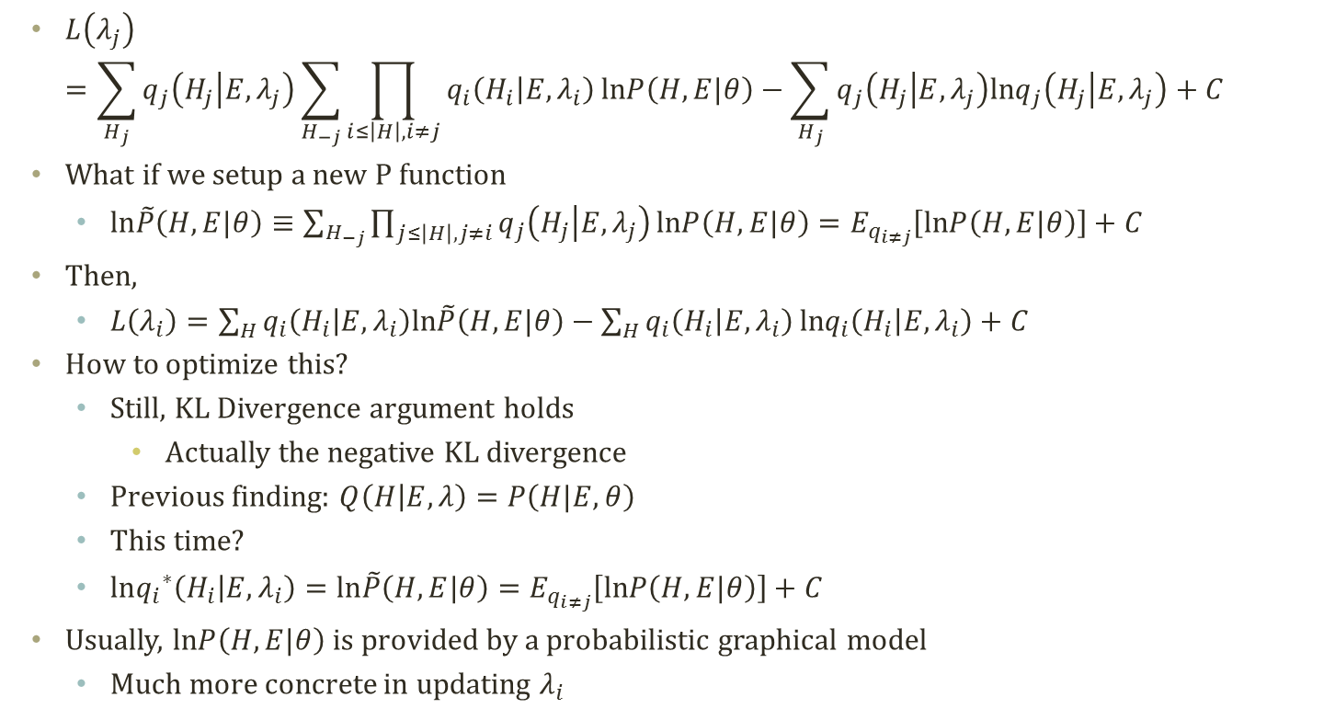
Freeform Optimization
$L\left(λ_{j}\right)$ $=\sum_{H_{j}}{q_{j}\left(H_{j} | E,λ_{j}\right)\sum_{H_{−j}}{\prod_{i≤\left|H\right|,i≠j}{q_{i}\left(H_{i} | E,λ_{i}\right)}lnP\left(H,E|θ\right)}}−\sum_{H_{j}}{q_{j}\left(H_{j} | E,λ_{j}\right)lnq_{j}\left(H_{j} | E,λ_{j}\right)}+C$
What if we setup a new P function
$ln\tilde{P}\left(H,E|θ\right)≡\sum_{H_{−j}}{\prod_{j≤\left|H\right|,j≠i}{q_{j}\left(H_{j} | E,λ_{j}\right)}lnP\left(H,E|θ\right)}=E_{q_{i≠j}}\left[lnP\left(H,E|θ\right)\right]+C$
Then,
$L\left(λ_{i}\right)=\sum_{H}{q_{i}\left(H_{i} | E,λ_{i}\right)ln\tilde{P}\left(H,E|θ\right)−\sum_{H}{q_{i}\left(H_{i} | E,λ_{i}\right)}lnq_{i}\left(H_{i} | E,λ_{i}\right)+C}$
How to optimize this?
Still, KL Divergence argument holds
Actually the negative KL divergence
Previous finding: $Q\left(H | E,λ\right)=P\left(H|E,θ\right)$
This time?
$ln{q_{i}}^{∗}\left(H_{i} | E,λ_{i}\right)=ln\tilde{P}\left(H,E|θ\right)=E_{q_{i≠j}}\left[lnP\left(H,E|θ\right)\right]+C$
Usually, $lnP\left(H,E|θ\right)$ is provided by a probabilistic graphical model
Much more concrete in updating $λ_{i}$

Slide 14
Examples of Variational inference

Slide 15

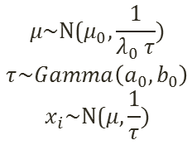



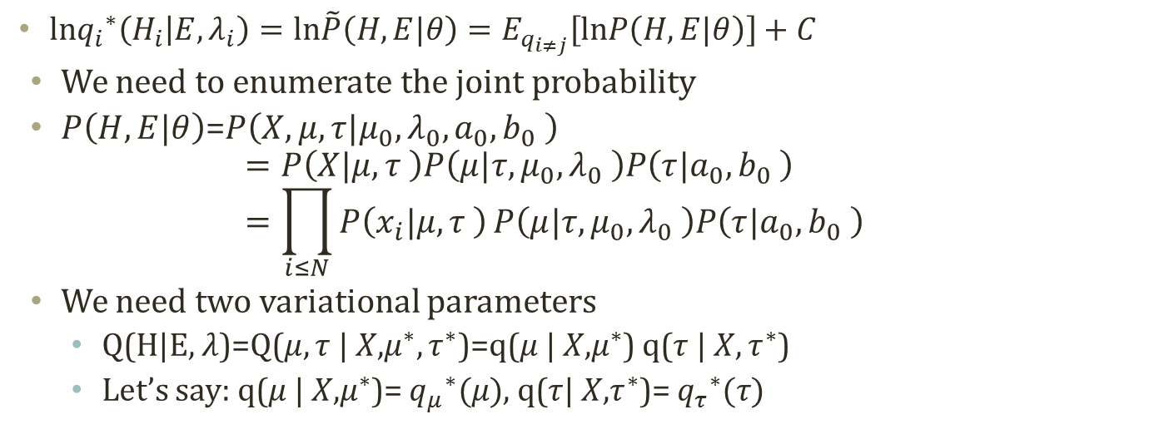






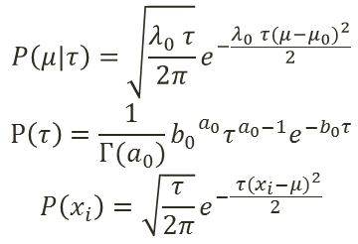
Simple Example Model
$$μ_{0}$$
$$λ_{0}$$
$$a_{0}$$
$$b_{0}$$
$$P\left(μ|τ\right)=\sqrt{\frac{λ_{0} τ}{2π}}e^{−\frac{λ_{0} τ{(μ−μ_{0})}^{2}}{2}} \\ P\left(τ\right)=\frac{1}{Γ(a_{0})}{b_{0}}^{a_{0}}τ^{a_{0}−1}e^{−b_{0}τ}$$
$$P\left(x_{i}\right)=\sqrt{\frac{τ}{2π}}e^{−\frac{ τ{(x_{i}−μ)}^{2}}{2}}$$
$$μ\text{\sim }\text{N}\text{(}μ_{0},\frac{1}{λ_{0} τ}) \\ τ\sim Gamma\left(a_{0},b_{0}\right)$$
$$x_{i}\text{\sim }\text{N}\text{(}μ,\frac{1}{τ})$$
$$μ$$
$$τ$$
$$x_{1}$$
$$x_{2}$$
$$x_{N−1}$$
$$x_{N}$$
$ln{q_{i}}^{∗}\left(H_{i} | E,λ_{i}\right)=ln\tilde{P}\left(H,E|θ\right)=E_{q_{i≠j}}\left[lnP\left(H,E|θ\right)\right]+C$
We need to enumerate the joint probability
$P\left(H,E|θ\right)$=$P\left(X,μ,τ|μ_{0},λ_{0},a_{0},b_{0} \right)$ $=P\left(X|μ,τ \right)P\left(μ|τ,μ_{0},λ_{0} \right)P\left(τ|a_{0},b_{0} \right)=\prod_{i≤N}{P\left(x_{i}|μ,τ \right)}P\left(μ|τ,μ_{0},λ_{0} \right)P\left(τ|a_{0},b_{0} \right)$
We need two variational parameters
Q(H|E, $λ$)=Q($μ,τ$| $X$,$μ^{∗},τ^{∗}$)=q($μ$| $X$,$μ^{∗}$) q($τ$| $X,τ^{∗}$)
Let’s say: q($μ$| $X$,$μ^{∗}$)= ${q_{μ}}^{∗}(μ)$, q($τ$| $X$,$τ^{∗}$)= ${q_{τ}}^{∗}(τ)$

Slide 16
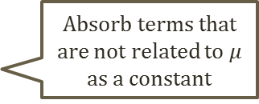
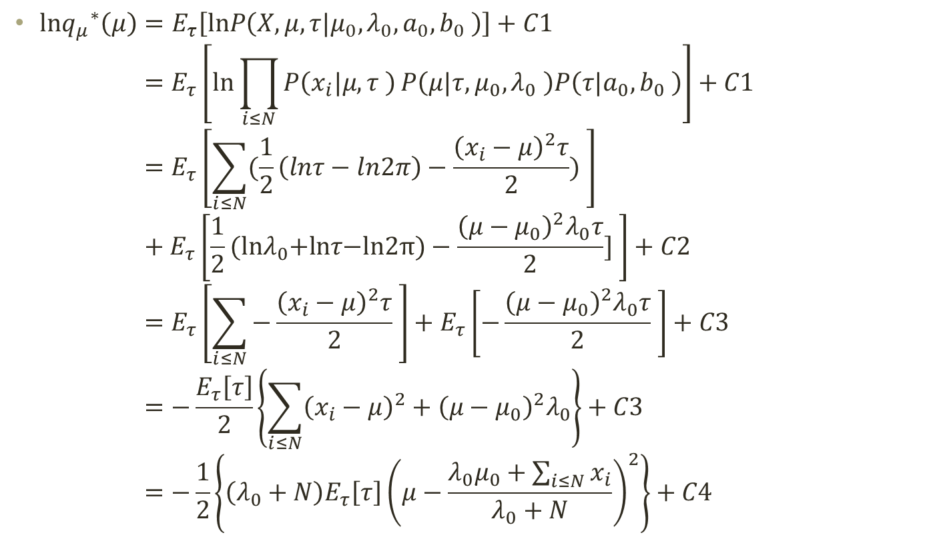

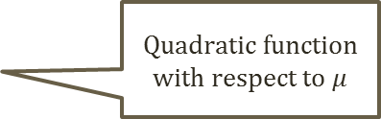
Calculate an Optimal Variational Parameter
$$P\left(μ|τ\right)=\sqrt{\frac{λ_{0} τ}{2π}}e^{−\frac{λ_{0} τ{(μ−μ_{0})}^{2}}{2}} \\ P\left(τ\right)=\frac{1}{Γ(a_{0})}{b_{0}}^{a_{0}}τ^{a_{0}−1}e^{−b_{0}τ}$$
$$P\left(x_{i}\right)=\sqrt{\frac{τ}{2π}}e^{−\frac{ τ{(x_{i}−μ)}^{2}}{2}}$$
$ln{q_{μ}}^{∗}\left(μ\right)=E_{τ}\left[lnP\left(X,μ,τ|μ_{0},λ_{0},a_{0},b_{0} \right)\right]+C1$ $=E_{τ}\left[\text{ln}\prod_{i≤N}{P\left(x_{i}|μ,τ \right)}P\left(μ|τ,μ_{0},λ_{0} \right)P\left(τ|a_{0},b_{0} \right)\right]+C1$ $=E_{τ}\left[\sum_{i≤N}{(\frac{1}{2}\left(lnτ−ln2π\right)−\frac{{\left(x_{i}−μ\right)}^{2}τ}{2})} \right]+E_{τ}\left[\frac{1}{2}\text{(}\text{ln}λ_{0}\text{+}\text{ln}τ\text{−}\text{ln}\text{2}π)−\frac{{\left(μ−μ_{0}\right)}^{2}λ_{0}τ}{2}] \right]+C2$ $=E_{τ}\left[\sum_{i≤N}{−\frac{{\left(x_{i}−μ\right)}^{2}τ}{2}} \right]+E_{τ}\left[−\frac{{\left(μ−μ_{0}\right)}^{2}λ_{0}τ}{2} \right]+C3$ $=−\frac{E_{τ}\left[τ\right]}{2}\left\{\sum_{i≤N}{{\left(x_{i}−μ\right)}^{2}}+{\left(μ−μ_{0}\right)}^{2}λ_{0}\right\}+C3$ $=−\frac{1}{2}\left\{\left(λ_{0}+N\right)E_{τ}\left[τ\right]{\left(μ−\frac{λ_{0}μ_{0}+\sum_{i≤N}{x_{i}}}{λ_{0}+N}\right)}^{2}\right\}+C4$
Absorb terms that are not related to $μ$ as a constant
Quadratic function with respect to $μ$

Slide 17

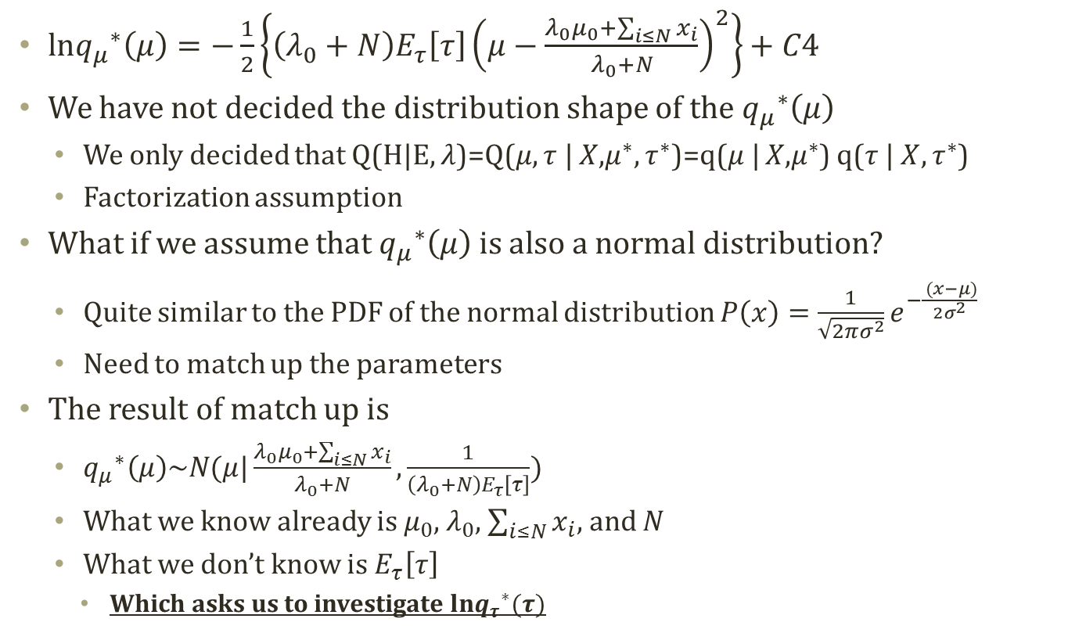
Calculate an Optimal Variational Parameter
$$P\left(μ|τ\right)=\sqrt{\frac{λ_{0} τ}{2π}}e^{−\frac{λ_{0} τ{(μ−μ_{0})}^{2}}{2}} \\ P\left(τ\right)=\frac{1}{Γ(a_{0})}{b_{0}}^{a_{0}}τ^{a_{0}−1}e^{−b_{0}τ}$$
$$P\left(x_{i}\right)=\sqrt{\frac{τ}{2π}}e^{−\frac{ τ{(x_{i}−μ)}^{2}}{2}}$$
$ln{q_{μ}}^{∗}\left(μ\right)=−\frac{1}{2}\left\{\left(λ_{0}+N\right)E_{τ}\left[τ\right]{\left(μ−\frac{λ_{0}μ_{0}+\sum_{i≤N}{x_{i}}}{λ_{0}+N}\right)}^{2}\right\}+C4$
We have not decided the distribution shape of the ${q_{μ}}^{∗}\left(μ\right)$
We only decided that Q(H|E, $λ$)=Q($μ,τ$| $X$,$μ^{∗},τ^{∗}$)=q($μ$| $X$,$μ^{∗}$) q($τ$| $X,τ^{∗}$)
Factorization assumption
What if we assume that ${q_{μ}}^{∗}\left(μ\right)$ is also a normal distribution?
Quite similar to the PDF of the normal distribution $P\left(x\right)=\frac{1}{\sqrt{2πσ^{2}}}e^{−\frac{ (x−μ)}{2σ^{2}}}$
Need to match up the parameters
The result of match up is
${q_{μ}}^{∗}\left(μ\right)\sim N(μ|\frac{λ_{0}μ_{0}+\sum_{i≤N}{x_{i}}}{λ_{0}+N},\frac{1}{\left(λ_{0}+N\right)E_{τ}\left[τ\right]})$
What we know already is $μ_{0}$, $λ_{0}$, $\sum_{i≤N}{x_{i}}$, and $N$
What we don’t know is $E_{τ}\left[τ\right]$
Which asks us to investigate $ln{q_{τ}}^{∗}(τ)$

Slide 18

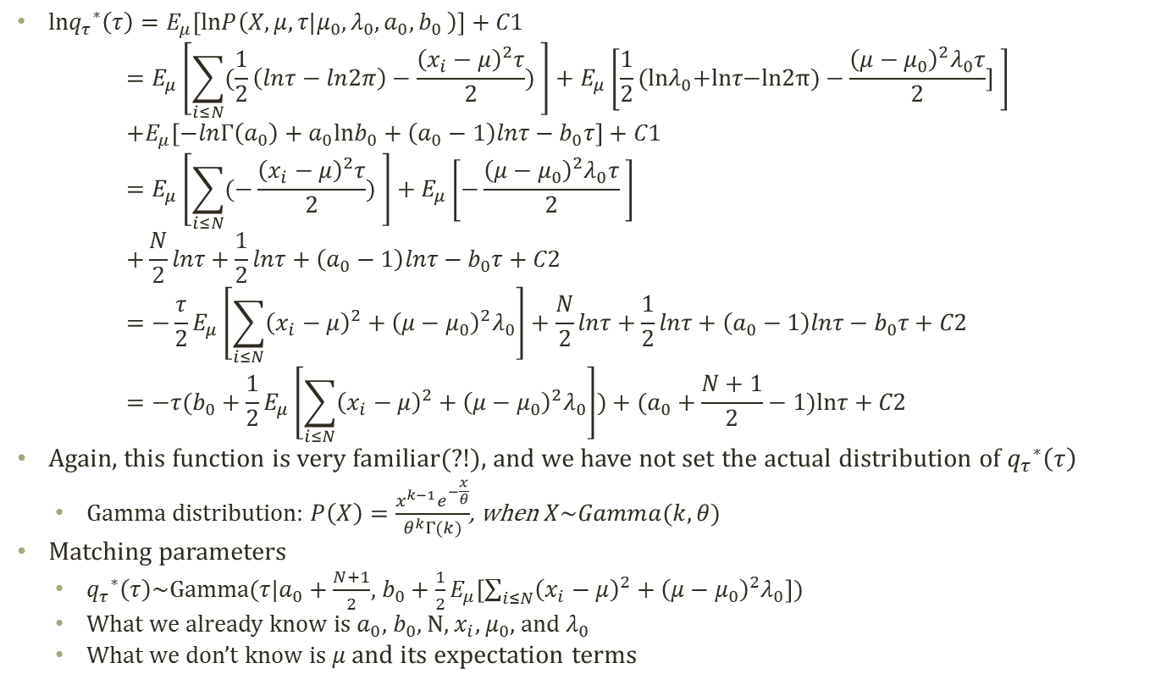
Calculate an Optimal Variational Parameter
$$P\left(μ|τ\right)=\sqrt{\frac{λ_{0} τ}{2π}}e^{−\frac{λ_{0} τ{(μ−μ_{0})}^{2}}{2}} \\ P\left(τ\right)=\frac{1}{Γ(a_{0})}{b_{0}}^{a_{0}}τ^{a_{0}−1}e^{−b_{0}τ}$$
$$P\left(x_{i}\right)=\sqrt{\frac{τ}{2π}}e^{−\frac{ τ{(x_{i}−μ)}^{2}}{2}}$$
$ln{q_{τ}}^{∗}\left(τ\right)=E_{μ}\left[lnP\left(X,μ,τ|μ_{0},λ_{0},a_{0},b_{0} \right)\right]+C1$ $=E_{μ}\left[\sum_{i≤N}{(\frac{1}{2}\left(lnτ−ln2π\right)−\frac{{\left(x_{i}−μ\right)}^{2}τ}{2})} \right]+E_{μ}\left[\frac{1}{2}\text{(}\text{ln}λ_{0}\text{+}\text{ln}τ\text{−}\text{ln}\text{2}π)−\frac{{\left(μ−μ_{0}\right)}^{2}λ_{0}τ}{2}] \right]$ $+E_{μ}\left[−lnΓ\left(a_{0}\right)+a_{0}lnb_{0}+\left(a_{0}−1\right)lnτ−b_{0}τ\right]+C1$ $=E_{μ}\left[\sum_{i≤N}{(−\frac{{\left(x_{i}−μ\right)}^{2}τ}{2})} \right]+E_{μ}\left[−\frac{{\left(μ−μ_{0}\right)}^{2}λ_{0}τ}{2} \right]$ $+\frac{N}{2}lnτ+\frac{1}{2}lnτ+\left(a_{0}−1\right)lnτ−b_{0}τ+C2$ $=−\frac{τ}{2}E_{μ}\left[\sum_{i≤N}{{\left(x_{i}−μ\right)}^{2}}+{\left(μ−μ_{0}\right)}^{2}λ_{0}\right]+\frac{N}{2}lnτ+\frac{1}{2}lnτ+\left(a_{0}−1\right)lnτ−b_{0}τ+C2$ $=−τ(b_{0}+\frac{1}{2}E_{μ}\left[\sum_{i≤N}{{\left(x_{i}−μ\right)}^{2}}+{\left(μ−μ_{0}\right)}^{2}λ_{0}\right])+(a_{0}+\frac{N+1}{2}−1)lnτ+C2$
Again, this function is very familiar(?!), and we have not set the actual distribution of ${q_{τ}}^{∗}\left(τ\right)$
Gamma distribution: $P\left(X\right)=\frac{x^{k−1}e^{−\frac{x}{θ}}}{θ^{k}Γ(k)}$, when $X\sim Gamma(k,θ)$
Matching parameters
${q_{τ}}^{∗}\left(τ\right)$~Gamma($τ$|$a_{0}+\frac{N+1}{2}$, $b_{0}+\frac{1}{2}E_{μ}\left[\sum_{i≤N}{{\left(x_{i}−μ\right)}^{2}}+{\left(μ−μ_{0}\right)}^{2}λ_{0}\right]$)
What we already know is $a_{0}$, $b_{0}$, N, $x_{i}$, $μ_{0}$, and $λ_{0}$
What we don’t know is $μ$ and its expectation terms

Slide 19
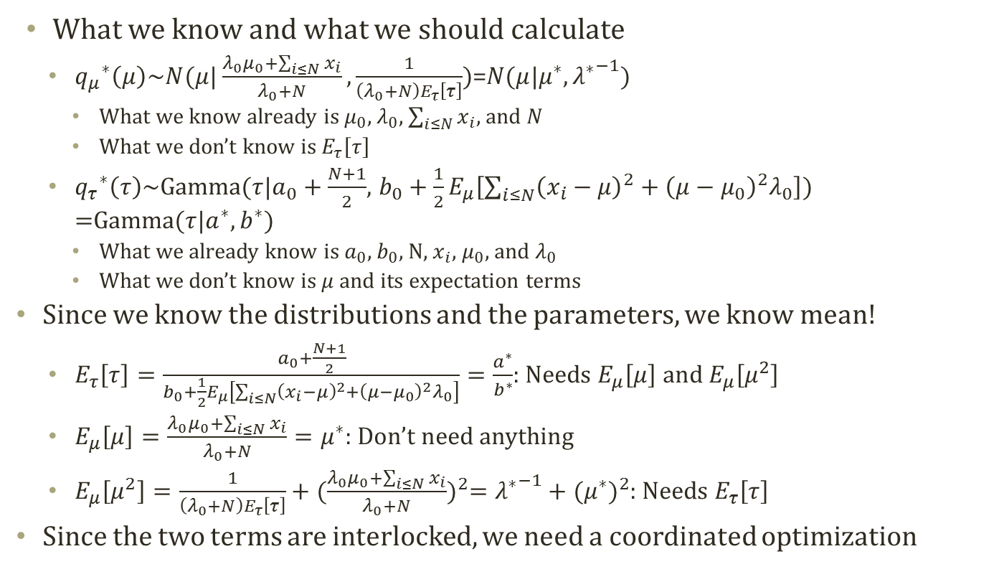
Coordinated Update
What we know and what we should calculate
${q_{μ}}^{∗}\left(μ\right)\sim N(μ|\frac{λ_{0}μ_{0}+\sum_{i≤N}{x_{i}}}{λ_{0}+N},\frac{1}{\left(λ_{0}+N\right)E_{τ}\left[τ\right]})$=$N(μ|μ^{∗},{λ^{∗}}^{−1})$
What we know already is $μ_{0}$, $λ_{0}$, $\sum_{i≤N}{x_{i}}$, and $N$
What we don’t know is $E_{τ}\left[τ\right]$
${q_{τ}}^{∗}\left(τ\right)$~Gamma($τ$|$a_{0}+\frac{N+1}{2}$, $b_{0}+\frac{1}{2}E_{μ}\left[\sum_{i≤N}{{\left(x_{i}−μ\right)}^{2}}+{\left(μ−μ_{0}\right)}^{2}λ_{0}\right]$) =Gamma($τ|a^{∗},b^{∗})$
What we already know is $a_{0}$, $b_{0}$, N, $x_{i}$, $μ_{0}$, and $λ_{0}$
What we don’t know is $μ$ and its expectation terms
Since we know the distributions and the parameters, we know mean!
$E_{τ}\left[τ\right]=\frac{a_{0}+\frac{N+1}{2}}{b_{0}+\frac{1}{2}E_{μ}\left[\sum_{i≤N}{{\left(x_{i}−μ\right)}^{2}}+{\left(μ−μ_{0}\right)}^{2}λ_{0}\right]}=\frac{a^{∗}}{b^{∗}}$: Needs $E_{μ}\left[μ\right]$ and $E_{μ}\left[μ^{2}\right]$
$E_{μ}\left[μ\right]=\frac{λ_{0}μ_{0}+\sum_{i≤N}{x_{i}}}{λ_{0}+N}=μ^{∗}$: Don’t need anything
$E_{μ}\left[μ^{2}\right]=\frac{1}{\left(λ_{0}+N\right)E_{τ}\left[τ\right]}+{(\frac{λ_{0}μ_{0}+\sum_{i≤N}{x_{i}}}{λ_{0}+N})}^{2}={λ^{∗}}^{−1}+{(μ^{∗})}^{2}$: Needs $E_{τ}\left[τ\right]$
Since the two terms are interlocked, we need a coordinated optimization

Slide 20




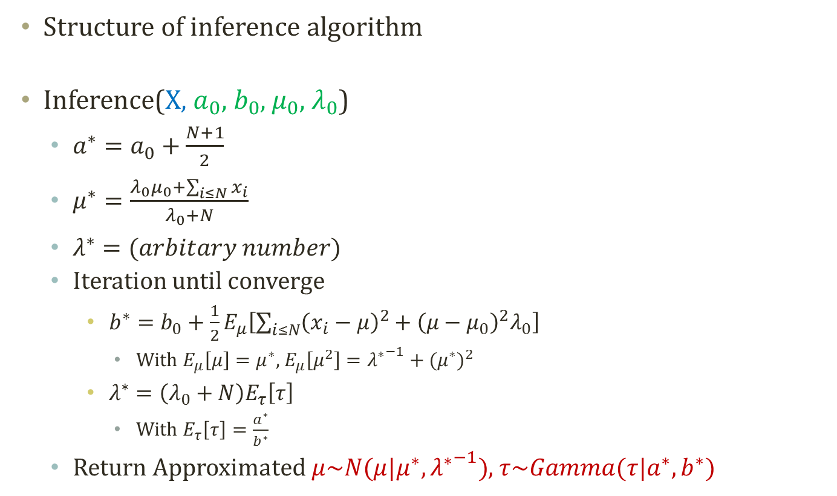






Algorithm for the Parameter Update
Structure of inference algorithm
Inference(X, $a_{0}$, $b_{0}$, $μ_{0}$, $λ_{0}$)
$a^{∗}=a_{0}+\frac{N+1}{2}$
$μ^{∗}=\frac{λ_{0}μ_{0}+\sum_{i≤N}{x_{i}}}{λ_{0}+N}$
$λ^{∗}=(arbitary number)$
Iteration until converge
$b^{∗}=b_{0}+\frac{1}{2}E_{μ}\left[\sum_{i≤N}{{\left(x_{i}−μ\right)}^{2}}+{\left(μ−μ_{0}\right)}^{2}λ_{0}\right]$
With $E_{μ}\left[μ\right]=μ^{∗}$, $E_{μ}\left[μ^{2}\right]={λ^{∗}}^{−1}+{(μ^{∗})}^{2}$
$λ^{∗}=\left(λ_{0}+N\right)E_{τ}\left[τ\right]$
With $E_{τ}\left[τ\right]=\frac{a^{∗}}{b^{∗}}$
Return Approximated $μ\sim N(μ|μ^{∗},{λ^{∗}}^{−1})$, $τ\sim Gamma(τ|a^{∗},b^{∗})$
Assumed
$$μ_{0}$$
$$λ_{0}$$
$$a_{0}$$
$$b_{0}$$
Inferred
$$μ$$
$$τ$$
$$x_{1}$$
$$x_{2}$$
$$x_{N−1}$$
$$x_{N}$$
Observed

Slide 21



Generalized Step-By-Step Instruction
1. Create a Probabilistic Graphical Model
4. For each partition $H_{i}$: Find a best approximating distribution ${q_{j}}^{∗}(H_{j}|E)$ by performing
$$\text{ln} {q_{j}}^{∗}\left(H_{j} | E\right)=E_{i≠j}\left[lnP\left(Z,X\right)\right]+C$$
6. If there are interacting distribution parameters across distributions of partitions, then use an iterative approach like Expectation-Maximization Approach
2. Find the data (E), the parameters ($θ$), and a latent variables (H)
3. Partition H into small subsets: Full factorization→Mean field approximation
7. You now have an optimized set of parameters for each latent variation partitions
5. Find the sets of probability distribution parameters by each ${q_{j}}^{∗}\left(H_{j} | E\right)$

Slide 22
Variational inference of Latent Dirichlet Allocation

Slide 23
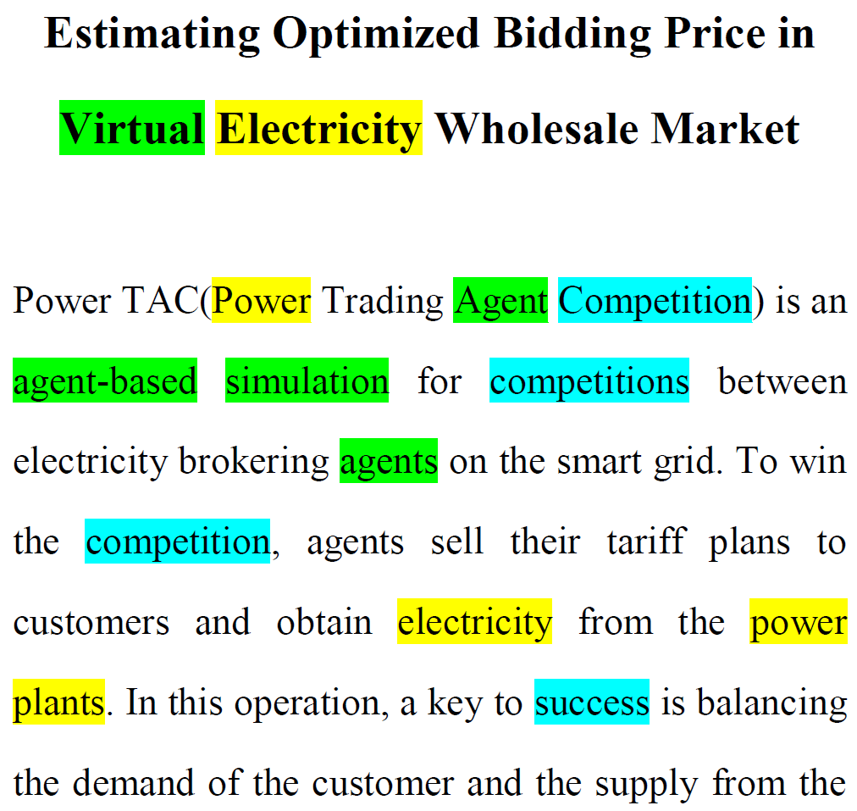
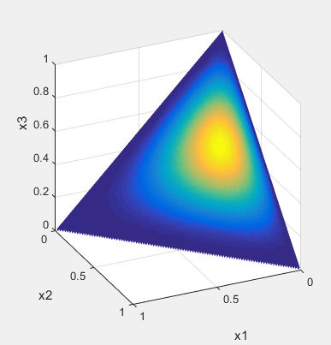
Detour: Latent Dirichlet Allocation
Blei, David M., Andrew Y. Ng, and Michael I. Jordan. "Latent dirichlet allocation." Journal of machine Learning research 3.Jan (2003): 993-1022.
Latent Dirichlet Allocation
Soft clustering in text data
Has the structure of text corpus
Is a Bayesian model with priors
For each word $w$, sample topic assignment $z$
$$α$$
$$θ$$
z
w
$$φ$$
$$β$$
N
M
K
Prob.
Topic 1 2 3 $⋯$
Dirichlet Distribution
Prior
Document specific
topic proportion
Topic assignment
Notes:
We shall begin by discussing Bayesian networks, also known as directed graphical models, in which the links of the graphs have a particular directionality indicated by arrows. The other major class of graphical models are Markov random fields, also known as undirected graphical models, in which the links do not carry arrows and have no directional significance.

Slide 24


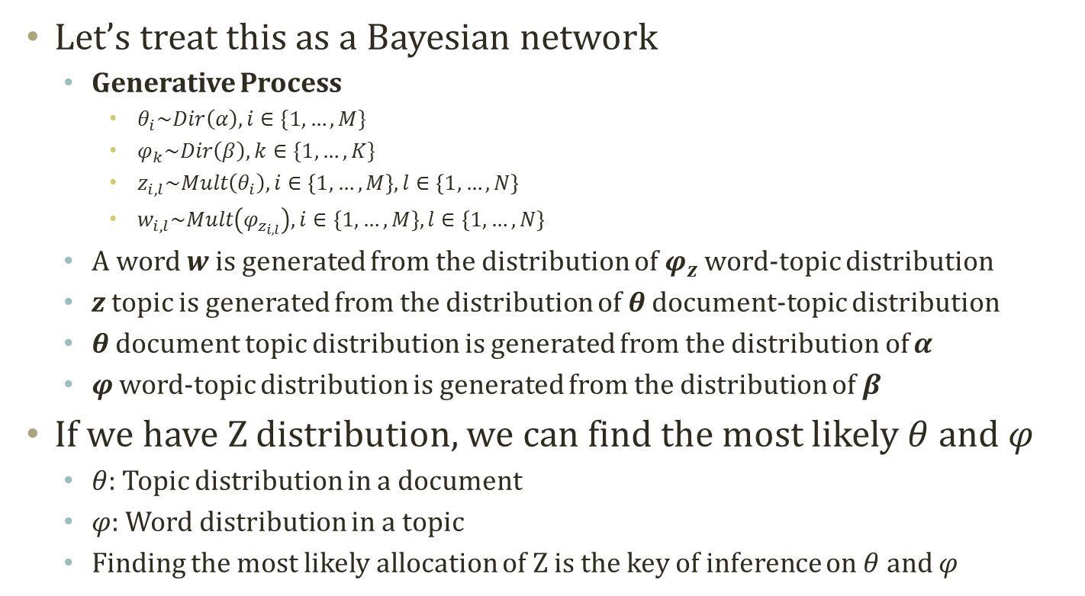


Detour: Finding Topic Assignment Per Word
Let’s treat this as a Bayesian network
Generative Process
$θ_{i}\sim Dir\left(α\right),i∈\{1,…,M\}$
$φ_{k}\sim Dir\left(β\right),k∈\{1,…,K\}$
$z_{i,l}\sim Mult\left(θ_{i}\right),i∈\left\{1,…,M\right\},l∈\left\{1,…,N\right\}$
$w_{i,l}\sim Mult\left(φ_{z_{i,l}}\right),i∈\left\{1,…,M\right\},l∈\left\{1,…,N\right\}$
A word w is generated from the distribution of $φ_{z}$ word-topic distribution
z topic is generated from the distribution of $θ$ document-topic distribution
$θ$ document topic distribution is generated from the distribution of $α$
$φ$ word-topic distribution is generated from the distribution of $β$
If we have Z distribution, we can find the most likely $θ$ and $φ$
$θ$: Topic distribution in a document
$φ$: Word distribution in a topic
Finding the most likely allocation of Z is the key of inference on $θ$ and $φ$
$$α$$
$$θ$$
z
w
$$φ$$
$$β$$
N
M
K

Slide 25

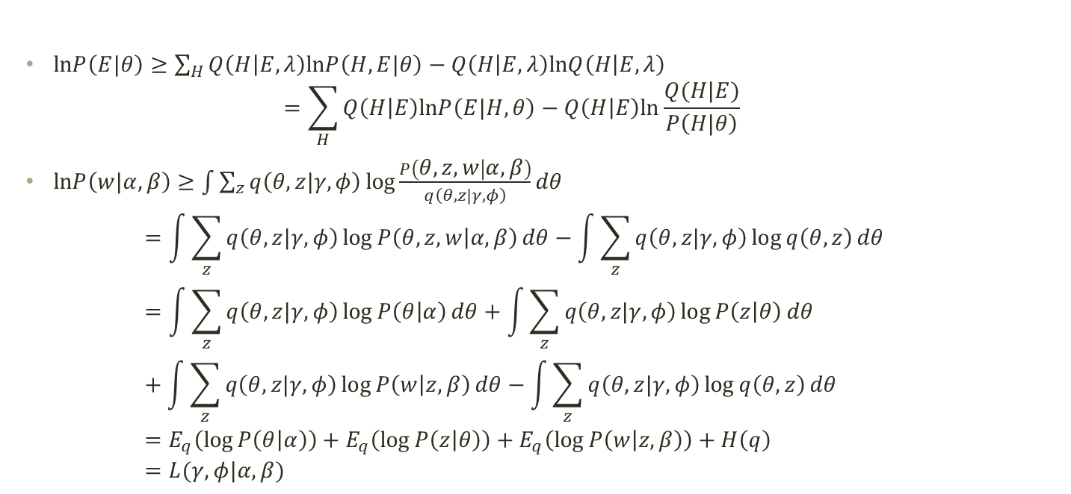
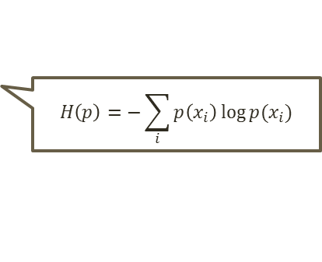

Evidence Lower Bound of LDA
$$α$$
$$θ$$
z
w
$$β$$
N
M
$lnP\left(E|θ\right)≥\sum_{H}{Q\left(H | E,λ\right)lnP\left(H,E|θ\right)−Q\left(H | E,λ\right)lnQ\left(H | E,λ\right)}$ $=\sum_{H}{Q\left(H | E\right)lnP\left(E|H,θ\right)−Q\left(H | E\right)ln\frac{Q(H|E)}{P\left(H|θ\right)} }$
$lnP\left(w|α,β\right)≥\int{\sum_{z}{q\left(θ,z|γ,φ\right)\log{\frac{P\left(θ,z,w | α,β\right)}{q\left(θ,z|γ,φ\right)}}}dθ}$ $=\int{\sum_{z}{q\left(θ,z|γ,φ\right)\log{P\left(θ,z,w | α,β\right)}}dθ}−\int{\sum_{z}{q\left(θ,z|γ,φ\right)\log{q\left(θ,z\right)}}dθ}$ $=\int{\sum_{z}{q\left(θ,z|γ,φ\right)\log{P\left(θ | α\right)}}dθ}+\int{\sum_{z}{q\left(θ,z|γ,φ\right)\log{P\left(z | θ\right)}}dθ}+\int{\sum_{z}{q\left(θ,z|γ,φ\right)\log{P\left(w | z,β\right)}}dθ}−\int{\sum_{z}{q\left(θ,z|γ,φ\right)\log{q\left(θ,z\right)}}dθ}$ $=E_{q}\left(\log{P\left(θ | α\right)}\right)+E_{q}\left(\log{P\left(z | θ\right)}\right)+E_{q}\left(\log{P\left(w | z,β\right)}\right)+H\left(q\right)$ $=L(γ,φ|α,β)$
$$H\left(p\right)=−\sum_{i}{p\left(x_{i}\right)\log{p(x_{i})}}$$

Slide 26
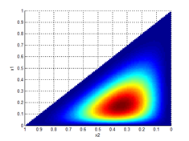
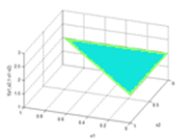
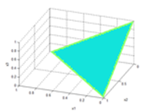
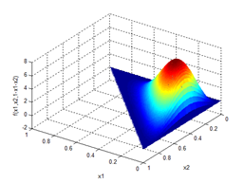
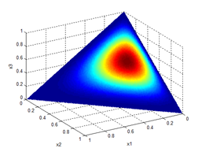
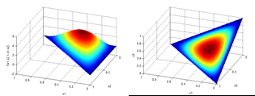


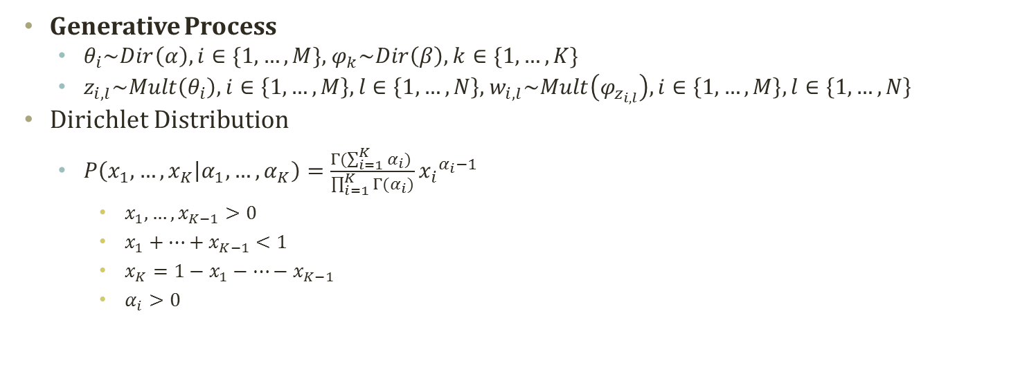



Detour: Dirichlet Distribution
Generative Process
$θ_{i}\sim Dir\left(α\right),i∈\{1,…,M\}$, $φ_{k}\sim Dir\left(β\right),k∈\{1,…,K\}$
$z_{i,l}\sim Mult\left(θ_{i}\right),i∈\left\{1,…,M\right\},l∈\left\{1,…,N\right\}$, $w_{i,l}\sim Mult\left(φ_{z_{i,l}}\right),i∈\left\{1,…,M\right\},l∈\left\{1,…,N\right\}$
Dirichlet Distribution
$P\left(x_{1},…,x_{K} | α_{1},…,α_{K}\right)=\frac{Γ(\sum_{i=1}^{K}{α_{i}}) }{\prod_{i=1}^{K}{Γ(α_{i})}}{x_{i}}^{α_{i}−1}$
$x_{1},…,x_{K−1}>0$
$x_{1}+…+x_{K−1}<1$
$x_{K}=1−x_{1}−…−x_{K−1}$
$α_{i}>0$
$$α$$
$$θ$$
z
w
$$β$$
N
M
$$\left[α_{1},α_{2},α_{3}\right]=[1,1,1]$$
$$\left[α_{1},α_{2},α_{3}\right]=[2,3,4]$$
$$\left[α_{1},α_{2},α_{3}\right]=[2,2,2]$$

Slide 27

Detour: Exponential Family
Exponential Family
$P\left(x | θ\right)=h\left(x\right)exp⁡(η\left(θ\right)∙T\left(x\right)−A\left(θ\right))$
Sufficient statistics : $T\left(x\right)$, Natural parameter : $η\left(θ\right)$
Underlying measure : $h\left(x\right)$, Log normalizer : $A\left(θ\right)$
Normal Distribution : $P\left(x | μ,σ\right)=\frac{1}{\sqrt{2πσ^{2}}}exp⁡(−\frac{{\left(x−μ\right)}^{2}}{2σ^{2}})$
Sufficient statistics : ${(x,x^{2})}^{T}$, Natural parameter :${(\frac{μ}{σ^{2}},−\frac{1}{{2σ}^{2}})}^{T}$
Underlying measure :$\frac{1}{\sqrt{2π}}$, Log normalizer :$\frac{μ^{2}}{2σ^{2}}+log⁡|σ|$
Dirichlet Distribution : $P\left(x_{1},…,x_{K} | α_{1},…,α_{K}\right)=\frac{Γ(\sum_{i=1}^{K}{α_{i}}) }{\prod_{i=1}^{K}{Γ(α_{i})}}{x_{i}}^{α_{i}−1}$
Sufficient statistics : ${(\log{x_{1}},…,\log{x_{K}})}^{T}$, Natural parameter :${(α_{1}−1,…,α_{K}−1)}^{T}$
Underlying measure :$1$, Log normalizer : $−\log{Γ\left(\sum_{i=1}^{K}{α_{i}}\right)}+\log{\prod_{i=1}^{K}{Γ(α_{i})}}$
Derivative of log normalizer → Moments of sufficient statistics
$\frac{d}{dη}a\left(η\right)=\frac{d}{dη}\log{\int{h\left(x\right)exp⁡\{η^{T}T\left(x\right)\}dx}}=\frac{\int{T\left(x\right)h\left(x\right)exp⁡\{η^{T}T\left(x\right)\}dx}}{\int{h\left(x\right)exp⁡\{η^{T}T\left(x\right)\}dx}}$ $=\frac{\int{T\left(x\right)h\left(x\right)exp⁡\{η^{T}T\left(x\right)\}dx}}{exp⁡(a\left(η\right)) }=\int{T\left(x\right)h\left(x\right)\exp\left\{η^{T}T\left(x\right)−a\left(η\right)\right\}dx}=E_{P}[T\left(x\right)]$

Slide 28





Derivation of $E_{q}\left(\log{P\left(θ | α\right)}\right)$
$$α$$
$$θ$$
z
w
$$β$$
N
M
$$P\left(x_{1},…,x_{K} | α_{1},…,α_{K}\right)=\frac{Γ(\sum_{i=1}^{K}{α_{i}}) }{\prod_{i=1}^{K}{Γ(α_{i})}}{x_{i}}^{α_{i}−1}$$
Further derivation of the first term in the evidence lower bound of LDA
$L(γ,φ|α,β)=E_{q}\left(\log{P\left(θ | α\right)}\right)+E_{q}\left(\log{P\left(z | θ\right)}\right)+E_{q}\left(\log{P\left(w | z,β\right)}\right)+H\left(q\right)$
$E_{q}\left(\log{P\left(θ | α\right)}\right)=E_{q}(\sum_{d=1}^{M}{\sum_{i=1}^{k}{\left(α_{i}−1\right)\log{θ_{d,i}}+\log{Γ\left(\sum_{i=1}^{K}{α_{i}}\right)}−\sum_{i=1}^{K}{\log{Γ\left(α_{i}\right)}}}})$
=$\sum_{d=1}^{M}{\sum_{i=1}^{k}{\left(α_{i}−1\right)E_{q}(\log{θ_{d,i}})}+\log{Γ\left(\sum_{i=1}^{K}{α_{i}}\right)}−\sum_{i=1}^{K}{\log{Γ\left(α_{i}\right)}}}$
$E_{q(θ,z|γ,φ)}\left(\log{θ_{d,i}}\right)=E_{q(θ|γ)q(z|φ)}\left(\log{θ_{d,i}}\right)=E_{q(θ|γ) }\left(\log{θ_{d,i}}\right)$
$q(θ|γ)$ can be assumed to follow the Dirichlet distribution
Derivative of log normalizer → Moments of sufficient statistics
Sufficient statistics : ${(\log{θ_{d,1}},…,\log{θ_{d,K}})}^{T}$
Log normalizer : $−\log{Γ\left(\sum_{i=1}^{K}{γ_{d,i}}\right)}+\log{\prod_{i=1}^{K}{Γ(γ_{d,i})}}$
$E_{q(θ|γ) }\left(\log{θ_{d,i}}\right)=\frac{d}{dγ_{d,i}}\left(−\log{Γ\left(\sum_{i=1}^{K}{γ_{d,i}}\right)}+\log{\prod_{i=1}^{K}{Γ\left(γ_{d,i}\right)}}\right)=−ψ\left(\sum_{i=1}^{K}{γ_{d,i}}\right)+ψ\left(γ_{d,i}\right)$
$ψ\left(γ_{d,i}\right)=\frac{d}{dγ_{i}}\log{Γ\left(γ_{d,i}\right)}=\frac{Γ^{′}\left(γ_{d,i}\right)}{Γ\left(γ_{d,i}\right)}$
Digamma function, calculation is based upon mathematical libraries (ex, scipy)
$E_{q}\left(\log{P\left(θ | α\right)}\right)$ $=\sum_{d=1}^{M}{\sum_{i=1}^{k}{\left(α_{i}−1\right)(−ψ\left(\sum_{i=1}^{K}{γ_{d,i}}\right)+ψ\left(γ_{d,i}\right)) }+\log{Γ\left(\sum_{i=1}^{K}{α_{i}}\right)}−\sum_{i=1}^{K}{\log{Γ\left(α_{i}\right)}}}$

Slide 29


Derivation of $E_{q}\left(\log{P\left(z | θ\right)}\right)$ and $E_{q}\left(\log{P\left(w | z,β\right)}\right)$
$$α$$
$$θ$$
z
w
$$β$$
N
M
$$P\left(x_{1},…,x_{K} | α_{1},…,α_{K}\right)=\frac{Γ(\sum_{i=1}^{K}{α_{i}}) }{\prod_{i=1}^{K}{Γ(α_{i})}}{x_{i}}^{α_{i}−1}$$
Further derivation of the second and the third terms in the evidence lower bound of LDA
$L(γ,φ|α,β)=E_{q}\left(\log{P\left(θ | α\right)}\right)+E_{q}\left(\log{P\left(z | θ\right)}\right)+E_{q}\left(\log{P\left(w | z,β\right)}\right)+H\left(q\right)$
$E_{q}\left(\log{P\left(z | θ\right)}\right)=\sum_{d=1}^{M}{\sum_{n=1}^{N_{d}}{E_{q}(\log{P\left(z_{d,n} | θ_{d}\right)})}=\sum_{d=1}^{M}{\sum_{n=1}^{N_{d}}{\sum_{i=1}^{K}{E_{q}(\log{P\left(z_{d,n,i} | θ_{d,i}\right)})}}} }$ $=\sum_{d=1}^{M}{\sum_{n=1}^{N_{d}}{\sum_{i=1}^{K}{E_{q}(\log{{θ_{d,i}}^{z_{d,n,i}}})}}}=\sum_{d=1}^{M}{\sum_{n=1}^{N_{d}}{\sum_{i=1}^{K}{E_{q(θ|γ)q(z|φ)}(z_{d,n,i}\log{θ_{d,i}})}}}=\sum_{d=1}^{M}{\sum_{n=1}^{N_{d}}{\sum_{i=1}^{K}{E_{q(z|φ)}(z_{d,n,i})E_{q(θ|γ)}(\log{θ_{d,i}})}}}$ $=\sum_{d=1}^{M}{\sum_{n=1}^{N_{d}}{\sum_{i=1}^{K}{φ_{n,i}(E_{q\left(θ | γ\right)}\left(\log{θ_{d,i}}\right))}}}=\sum_{d=1}^{M}{\sum_{n=1}^{N_{d}}{\sum_{i=1}^{K}{φ_{d,n,i}(−ψ\left(\sum_{i=1}^{K}{γ_{d,i}}\right)+ψ\left(γ_{d,i}\right) )}}}$
$∵E_{q(θ|γ) }\left(\log{θ_{d,i}}\right)=\frac{d}{dγ_{i}}\left(−\log{Γ\left(\sum_{i=1}^{K}{γ_{d,i}}\right)}+\log{\prod_{i=1}^{K}{Γ\left(γ_{d,i}\right)}}\right)=−ψ\left(\sum_{i=1}^{K}{γ_{d,i}}\right)+ψ\left(γ_{d,i}\right)$
$E_{q}\left(\log{P\left(w | z,β\right)}\right)=\sum_{d=1}^{M}{\sum_{n=1}^{N_{d}}{E_{q}\left(\log{P\left(w_{d,n} | z_{d,n},β\right)}\right)}}=\sum_{d=1}^{M}{\sum_{n=1}^{N_{d}}{\sum_{i=1}^{K}{E_{q}\left(\log{{β_{i,w_{d,n}}}^{z_{d,n,i}}}\right)}}}$ $=\sum_{d=1}^{M}{\sum_{n=1}^{N_{d}}{\sum_{i=1}^{K}{E_{q(θ|γ)q(z|φ)}\left(z_{d,n,i}\log{β_{i,w_{d,n}}}\right)}}}$ $=\sum_{d=1}^{M}{\sum_{n=1}^{N_{d}}{\sum_{i=1}^{K}{E_{q(z|φ)}\left(z_{d,n,i}\right)}\log{β_{i,w_{d,n}}}}}=\sum_{d=1}^{M}{\sum_{n=1}^{N_{d}}{\sum_{i=1}^{K}{φ_{d,n,i}}\log{β_{i,w_{d,n}}}}}$

Slide 30


Derivation of $H\left(q\right)$
Further derivation of the fourth term in the evidence lower bound of LDA
$L(γ,φ|α,β)=E_{q}\left(\log{P\left(θ | α\right)}\right)+E_{q}\left(\log{P\left(z | θ\right)}\right)+E_{q}\left(\log{P\left(w | z,β\right)}\right)+H\left(q\right)$
$H\left(q\right)=−\int{\sum_{z}{q\left(θ,z\right)\log{q\left(θ,z\right)}dθ}}=−\int{q\left(θ\right)\log{q\left(θ\right)}dθ}−\sum_{z}{q\left(z\right)\log{q\left(z\right)}}$
$\int{q\left(θ\right)\log{q\left(θ\right)}dθ}=E_{q\left(θ | γ\right)}\left(\log{q\left(θ | γ\right)}\right)$ $=\sum_{d=1}^{M}{\sum_{i=1}^{k}{\left(γ_{d,i}−1\right)(−ψ\left(\sum_{i=1}^{K}{γ_{d,i}}\right)+ψ\left(γ_{d,i}\right)) }+\log{Γ\left(\sum_{i=1}^{K}{γ_{d,i}}\right)}−\sum_{i=1}^{K}{\log{Γ\left(γ_{d,i}\right)}}}$
$E_{q\left(θ | γ\right)}\left(\log{P\left(θ | α\right)}\right)$ $=\sum_{d=1}^{M}{\sum_{i=1}^{k}{\left(α_{i}−1\right)(−ψ\left(\sum_{i=1}^{K}{γ_{d,i}}\right)+ψ\left(γ_{d,i}\right)) }+\log{Γ\left(\sum_{i=1}^{K}{α_{i}}\right)}−\sum_{i=1}^{K}{\log{Γ\left(α_{i}\right)}}}$
$\sum_{z}{q\left(z\right)\log{q\left(z\right)}}$=$E_{q\left(z | φ\right)}\left(\log{q\left(z | φ\right)}\right)$ $=\sum_{d=1}^{M}{\sum_{n=1}^{N_{d}}{\sum_{i=1}^{K}{φ_{d,n,i}}\log{φ_{d,n,i}}}}$
$E_{q\left(θ | γ\right)q\left(z | φ\right)}\left(\log{P\left(z | θ\right)}\right)$ $=\sum_{d=1}^{M}{\sum_{n=1}^{N_{d}}{\sum_{i=1}^{K}{φ_{d,n,i}(−ψ\left(\sum_{i=1}^{K}{γ_{d,i}}\right)+ψ\left(γ_{d,i}\right) )}}}$
$H\left(q\right)$ $=−\sum_{d=1}^{M}{\sum_{i=1}^{k}{\left(γ_{d,i}−1\right)(−ψ\left(\sum_{i=1}^{K}{γ_{d,i}}\right)+ψ\left(γ_{d,i}\right)) }−\log{Γ\left(\sum_{i=1}^{K}{γ_{d,i}}\right)}+\sum_{i=1}^{K}{\log{Γ\left(γ_{d,i}\right)}}}−\sum_{d=1}^{M}{\sum_{n=1}^{N_{d}}{\sum_{i=1}^{K}{φ_{d,n,i}}\log{φ_{d,n,i}}}}$

Slide 31



Evidence Lower Bound of LDA after Derivation
$$α$$
$$θ$$
z
w
$$β$$
N
M
$lnP\left(w|α,β\right)≥L\left(γ,φ | α,β\right)$ $=E_{q}\left(\log{P\left(θ | α\right)}\right)+E_{q}\left(\log{P\left(z | θ\right)}\right)+E_{q}\left(\log{P\left(w | z,β\right)}\right)+H\left(q\right)$ $=\sum_{d=1}^{M}{\sum_{i=1}^{k}{\left(α_{i}−1\right)(−ψ\left(\sum_{i=1}^{K}{γ_{d,i}}\right)+ψ\left(γ_{d,i}\right)) }+\log{Γ\left(\sum_{i=1}^{K}{α_{i}}\right)}−\sum_{i=1}^{K}{\log{Γ\left(α_{i}\right)}}}$ $+\sum_{d=1}^{M}{\sum_{n=1}^{N_{d}}{\sum_{i=1}^{K}{φ_{d,n,i}(−ψ\left(\sum_{i=1}^{K}{γ_{d,i}}\right)+ψ\left(γ_{d,i}\right) )}}}$ $+\sum_{d=1}^{M}{\sum_{n=1}^{N_{d}}{\sum_{i=1}^{K}{φ_{d,n,i}}\log{β_{i,w_{d,n}}}}}$ $−\sum_{d=1}^{M}{\sum_{i=1}^{k}{\left(γ_{d,i}−1\right)(−ψ\left(\sum_{i=1}^{K}{γ_{d,i}}\right)+ψ\left(γ_{d,i}\right)) }−\log{Γ\left(\sum_{i=1}^{K}{γ_{d,i}}\right)}+\sum_{i=1}^{K}{\log{Γ\left(γ_{d,i}\right)}}}−\sum_{d=1}^{M}{\sum_{n=1}^{N_{d}}{\sum_{i=1}^{K}{φ_{d,n,i}}\log{φ_{d,n,i}}}}$

Slide 32



Learning Variational Parameters, $φ$
$$L\left(γ,φ | α,β\right) \\ =\sum_{d=1}^{M}{\sum_{i=1}^{k}{\left(α_{i}−1\right)(−ψ\left(\sum_{i=1}^{K}{γ_{d,i}}\right)+ψ\left(γ_{d,i}\right)) }+\log{Γ\left(\sum_{i=1}^{K}{α_{i}}\right)}−\sum_{i=1}^{K}{\log{Γ\left(α_{i}\right)}}} \\ +\sum_{d=1}^{M}{\sum_{n=1}^{N_{d}}{\sum_{i=1}^{K}{φ_{d,n,i}(−ψ\left(\sum_{i=1}^{K}{γ_{d,i}}\right)+ψ\left(γ_{d,i}\right) )}}} \\ +\sum_{d=1}^{M}{\sum_{n=1}^{N_{d}}{\sum_{i=1}^{K}{φ_{d,n,i}}\log{β_{i,w_{d,n}}}}} \\ −\sum_{d=1}^{M}{\sum_{i=1}^{k}{\left(γ_{d,i}−1\right)(−ψ\left(\sum_{i=1}^{K}{γ_{d,i}}\right)+ψ\left(γ_{d,i}\right)) }−\log{Γ\left(\sum_{i=1}^{K}{γ_{d,i}}\right)}+\sum_{i=1}^{K}{\log{Γ\left(γ_{d,i}\right)}}}−\sum_{d=1}^{M}{\sum_{n=1}^{N_{d}}{\sum_{i=1}^{K}{φ_{d,n,i}}\log{φ_{d,n,i}}}}$$
$lnP\left(w|α,β\right)≥L\left(γ,φ | α,β\right)$
$\frac{d}{dφ_{d,n,i}}L\left(γ,φ | α,β\right)$ $=\frac{d}{dφ_{d,n,i}}\left[\left\{\sum_{d=1}^{M}{\sum_{n=1}^{N_{d}}{\sum_{i=1}^{K}{φ_{d,n,i}(−ψ\left(\sum_{i=1}^{K}{γ_{d,i}}\right)+ψ\left(γ_{d,i}\right) )}}}+\sum_{d=1}^{M}{\sum_{n=1}^{N_{d}}{\sum_{i=1}^{K}{φ_{d,n,i}}\log{β_{i,w_{d,n}}}}}−\sum_{d=1}^{M}{\sum_{n=1}^{N_{d}}{\sum_{i=1}^{K}{φ_{d,n,i}}\log{φ_{d,n,i}}}}\right\}+λ_{d,n}(\sum_{i=1}^{K}{φ_{d,n,i}}−1)\right]$ $=\left(−ψ\left(\sum_{i=1}^{K}{γ_{d,i}}\right)+ψ\left(γ_{d,i}\right) \right)+\log{β_{i,w_{d,n}}}−\log{φ_{d,n,i}}−1+λ_{d,n}=0$
$\log{φ_{d,n,i}}=\log{β_{i,w_{d,n}}}+λ_{d,n}+ψ\left(γ_{d,i}\right)−ψ\left(\sum_{i=1}^{K}{γ_{d,i}}\right)−1$
$\exp\left(\log{φ_{d,n,i}}\right)=\exp\left(\log{β_{i,w_{d,n}}}+λ_{d,n}+ψ\left(γ_{d,i}\right)−ψ\left(\sum_{i=1}^{K}{γ_{d,i}}\right)−1\right)$
$φ_{d,n,i}=β_{i,w_{d,n}}\exp\left(λ_{d,n}+ψ\left(γ_{d,i}\right)−ψ\left(\sum_{i=1}^{K}{γ_{d,i}}\right)−1\right)$
$φ_{d,n,i}∝β_{i,w_{d,n}}\exp\left(ψ\left(γ_{d,i}\right)\right)$

Slide 33



Learning Variational Parameters, $γ$
$$L\left(γ,φ | α,β\right) \\ =\sum_{d=1}^{M}{\sum_{i=1}^{k}{\left(α_{i}−1\right)(−ψ\left(\sum_{i=1}^{K}{γ_{d,i}}\right)+ψ\left(γ_{d,i}\right)) }+\log{Γ\left(\sum_{i=1}^{K}{α_{i}}\right)}−\sum_{i=1}^{K}{\log{Γ\left(α_{i}\right)}}} \\ +\sum_{d=1}^{M}{\sum_{n=1}^{N_{d}}{\sum_{i=1}^{K}{φ_{d,n,i}(−ψ\left(\sum_{i=1}^{K}{γ_{d,i}}\right)+ψ\left(γ_{d,i}\right) )}}} \\ +\sum_{d=1}^{M}{\sum_{n=1}^{N_{d}}{\sum_{i=1}^{K}{φ_{d,n,i}}\log{β_{i,w_{d,n}}}}} \\ −\sum_{d=1}^{M}{\sum_{i=1}^{k}{\left(γ_{d,i}−1\right)(−ψ\left(\sum_{i=1}^{K}{γ_{d,i}}\right)+ψ\left(γ_{d,i}\right)) }−\log{Γ\left(\sum_{i=1}^{K}{γ_{d,i}}\right)}+\sum_{i=1}^{K}{\log{Γ\left(γ_{d,i}\right)}}}−\sum_{d=1}^{M}{\sum_{n=1}^{N_{d}}{\sum_{i=1}^{K}{φ_{d,n,i}}\log{φ_{d,n,i}}}}$$
$lnP\left(w|α,β\right)≥L\left(γ,φ | α,β\right)$
$\frac{d}{dγ_{d,i}}L\left(γ,φ | α,β\right)$ $=\frac{d}{dγ_{d,i}}\left[\sum_{d=1}^{M}{\sum_{i=1}^{k}{\left(α_{i}−1\right)(−ψ\left(\sum_{i=1}^{K}{γ_{d,i}}\right)+ψ\left(γ_{d,i}\right)) }}+\sum_{d=1}^{M}{\sum_{n=1}^{N_{d}}{\sum_{i=1}^{K}{φ_{d,n,i}(−ψ\left(\sum_{i=1}^{K}{γ_{d,i}}\right)+ψ\left(γ_{d,i}\right) )}}}−\sum_{d=1}^{M}{\sum_{i=1}^{k}{\left(γ_{d,i}−1\right)(−ψ\left(\sum_{i=1}^{K}{γ_{d,i}}\right)+ψ\left(γ_{d,i}\right)) }−\log{Γ\left(\sum_{i=1}^{K}{γ_{d,i}}\right)}+\sum_{i=1}^{K}{\log{Γ\left(γ_{d,i}\right)}}}\right]$ $=\left(α_{i}−1\right)\left(−ψ^{′}\left(\sum_{i=1}^{K}{γ_{d,i}}\right)+ψ^{′}\left(γ_{d,i}\right)\right)+\sum_{n=1}^{N_{d}}{φ_{d,n,i}(−ψ^{′}\left(\sum_{i=1}^{K}{γ_{d,i}}\right)+ψ^{′}\left(γ_{d,i}\right))}−\left(−ψ\left(\sum_{i=1}^{K}{γ_{d,i}}\right)+ψ\left(γ_{d,i}\right)\right)−\left(γ_{d,i}−1\right)\left(−ψ^{′}\left(\sum_{i=1}^{K}{γ_{d,i}}\right)+ψ^{′}\left(γ_{d,i}\right)\right)$ $−ψ\left(\sum_{i=1}^{K}{γ_{d,i}}\right)+ψ\left(γ_{d,i}\right)=\left(−ψ^{′}\left(\sum_{i=1}^{K}{γ_{d,i}}\right)+ψ^{′}\left(γ_{d,i}\right)\right)\left(α_{i}−1+\sum_{n=1}^{N_{d}}{φ_{d,n,i}}−\left(γ_{d,i}−1\right)\right)=0$
$α_{i}−1+\sum_{n=1}^{N_{d}}{φ_{d,n,i}}−\left(γ_{d,i}−1\right)=0$
$γ_{d,i}=α_{i}+\sum_{n=1}^{N_{d}}{φ_{d,n,i}}$

Slide 34


Learning Model Parameters, $β$
$$L\left(γ,φ | α,β\right) \\ =\sum_{d=1}^{M}{\sum_{i=1}^{k}{\left(α_{i}−1\right)(−ψ\left(\sum_{i=1}^{K}{γ_{d,i}}\right)+ψ\left(γ_{d,i}\right)) }+\log{Γ\left(\sum_{i=1}^{K}{α_{i}}\right)}−\sum_{i=1}^{K}{\log{Γ\left(α_{i}\right)}}} \\ +\sum_{d=1}^{M}{\sum_{n=1}^{N_{d}}{\sum_{i=1}^{K}{φ_{d,n,i}(−ψ\left(\sum_{i=1}^{K}{γ_{d,i}}\right)+ψ\left(γ_{d,i}\right) )}}} \\ +\sum_{d=1}^{M}{\sum_{n=1}^{N_{d}}{\sum_{i=1}^{K}{φ_{d,n,i}}\log{β_{i,w_{d,n}}}}} \\ −\sum_{d=1}^{M}{\sum_{i=1}^{k}{\left(γ_{d,i}−1\right)(−ψ\left(\sum_{i=1}^{K}{γ_{d,i}}\right)+ψ\left(γ_{d,i}\right)) }−\log{Γ\left(\sum_{i=1}^{K}{γ_{d,i}}\right)}+\sum_{i=1}^{K}{\log{Γ\left(γ_{d,i}\right)}}}−\sum_{d=1}^{M}{\sum_{n=1}^{N_{d}}{\sum_{i=1}^{K}{φ_{d,n,i}}\log{φ_{d,n,i}}}}$$
$lnP\left(w|α,β\right)≥L\left(γ,φ | α,β\right)$
$\frac{d}{dβ_{i,w_{d,n}}}L\left(γ,φ | α,β\right)$ $=\frac{d}{dβ_{i,w_{d,n}}}\left[\sum_{d=1}^{M}{\sum_{n=1}^{N_{d}}{\sum_{i=1}^{K}{φ_{d,n,i}}\log{β_{i,w_{d,n}}}}}+\sum_{i=1}^{K}{ρ_{i}(\sum_{v=1}^{V}{β_{i,v}−1})}\right]$
$β_{i,w_{d,n}}$→$β_{i,v}$ : $v$ is a unique word index of $w_{d,n}$
$\frac{d}{dβ_{i,v }}L\left(γ,φ | α,β\right)$ $=\frac{d}{dβ_{i,v}}\left[\sum_{d=1}^{M}{\sum_{n=1}^{N_{d}}{\sum_{v=1}^{V}{\sum_{i=1}^{K}{φ_{d,n,i}1(v=w_{d,n})\log{β_{i,v}}}}}}+\sum_{i=1}^{K}{ρ_{i}(\sum_{v=1}^{V}{β_{i,v}−1})}\right]$ $=\frac{\sum_{d=1}^{M}{\sum_{n=1}^{N_{d}}{φ_{d,n,i}1(v=w_{d,n}) }}}{β_{i,v}}+ρ_{i}=0$
$β_{i,v}∝\sum_{d=1}^{M}{\sum_{n=1}^{N_{d}}{φ_{d,n,i}1(v=w_{d,n}) }}$

Slide 35



Learning Model Parameters, $α$
$$L\left(γ,φ | α,β\right) \\ =\sum_{d=1}^{M}{\sum_{i=1}^{k}{\left(α_{i}−1\right)(−ψ\left(\sum_{i=1}^{K}{γ_{d,i}}\right)+ψ\left(γ_{d,i}\right)) }+\log{Γ\left(\sum_{i=1}^{K}{α_{i}}\right)}−\sum_{i=1}^{K}{\log{Γ\left(α_{i}\right)}}} \\ +\sum_{d=1}^{M}{\sum_{n=1}^{N_{d}}{\sum_{i=1}^{K}{φ_{d,n,i}(−ψ\left(\sum_{i=1}^{K}{γ_{d,i}}\right)+ψ\left(γ_{d,i}\right) )}}} \\ +\sum_{d=1}^{M}{\sum_{n=1}^{N_{d}}{\sum_{i=1}^{K}{φ_{d,n,i}}\log{β_{i,w_{d,n}}}}} \\ −\sum_{d=1}^{M}{\sum_{i=1}^{k}{\left(γ_{d,i}−1\right)(−ψ\left(\sum_{i=1}^{K}{γ_{d,i}}\right)+ψ\left(γ_{d,i}\right)) }−\log{Γ\left(\sum_{i=1}^{K}{γ_{d,i}}\right)}+\sum_{i=1}^{K}{\log{Γ\left(γ_{d,i}\right)}}}−\sum_{d=1}^{M}{\sum_{n=1}^{N_{d}}{\sum_{i=1}^{K}{φ_{d,n,i}}\log{φ_{d,n,i}}}}$$
$lnP\left(w|α,β\right)≥L\left(γ,φ | α,β\right)$
$\frac{d}{dα_{i}}L\left(γ,φ | α,β\right)$ $=\frac{d}{dα_{i}}\left[\sum_{d=1}^{M}{\sum_{i=1}^{k}{\left(α_{i}−1\right)(−ψ\left(\sum_{i=1}^{K}{γ_{d,i}}\right)+ψ\left(γ_{d,i}\right)) }+\log{Γ\left(\sum_{i=1}^{K}{α_{i}}\right)}−\sum_{i=1}^{K}{\log{Γ\left(α_{i}\right)}}}\right]$ $=\sum_{d=1}^{M}{\left[−ψ\left(\sum_{i=1}^{K}{γ_{d,i}}\right)+ψ\left(γ_{d,i}\right)+ψ\left(\sum_{i=1}^{K}{α_{i}}\right)−ψ\left(α_{i}\right)\right]}$
Unable to create a closed form solution → Approximated Optimization : $\max_{α}L\left(γ,φ | α,β\right)$
We will use the Newton-Rhapson method
$\frac{d^{2}}{dα_{i}dα_{j}}L\left(γ,φ | α,β\right)=\frac{d}{dα_{j}}\left[\sum_{d=1}^{M}{\left[−ψ\left(\sum_{i=1}^{K}{γ_{d,i}}\right)+ψ\left(γ_{d,i}\right)\right]}+Mψ\left(\sum_{i=1}^{K}{α_{i}}\right)−Mψ\left(α_{i}\right)\right]$ $=Mψ^{′}\left(\sum_{i=1}^{K}{α_{i}}\right)−ψ^{′}\left(α_{i}\right)M1(i=j)$
Hessian Matrix : a square matrix of second-order partial derivatives of a scalar-valued function. The matrix describes the curvature of the function from different perspectives.
$$\left[\begin{matrix}\begin{matrix}\frac{∂^{2}f}{∂x_{1}^{2}} & \frac{∂^{2}f}{∂x_{1}x_{2}} \\ \frac{∂^{2}f}{∂x_{2}x_{1}} & \frac{∂^{2}f}{∂x_{2}^{2}}\end{matrix} & ⋯ & \begin{matrix}\frac{∂^{2}f}{∂x_{1}x_{n}} \\ \frac{∂^{2}f}{∂x_{2}x_{n}}\end{matrix} \\ ⋮ & ⋱ & ⋮ \\ \begin{matrix}\frac{∂^{2}f}{∂x_{n}x_{1}} & \frac{∂^{2}f}{∂x_{n}x_{2}}\end{matrix} & ⋯ & \frac{∂^{2}f}{∂x_{n}^{2}}\end{matrix}\right]$$

Slide 36

Detour: Newton-Rhapson Method
$f\left(x\right)$: differentiable function in the interested range
We want to find $r$ in the range of $x$such that $f\left(r\right)=0$
Deriving the Newton-Rhapson iteration
$f^{′}\left(x_{0}\right)=\lim_{h→0}{\frac{f\left(x_{0}+h\right)−f\left(x_{0}\right)}{h}}$
Assume $r=x_{0}+h$
$f\left(r\right)=f\left(x_{0}+h\right)=f\left(x_{0}\right)+hf^{′}\left(x_{0}\right)≈0$, if $h$ is very small
$h≈−\frac{f\left(x_{0}\right)}{f^{′}\left(x_{0}\right)} →r=x_{0}−\frac{f\left(x_{0}\right)}{f^{′}\left(x_{0}\right)}$
$x_{n+1}=x_{n}−\frac{f\left(x_{n}\right)}{f^{′}\left(x_{n}\right)}$
We want to find $r$ in the range of $x$such that $f\left(r\right)=\max_{x}f\left(x\right)$
The gradient, $f^{′}\left(x\right),$ must be zero
Apply the Newton-Rhapson to the gradient function
$x_{n+1}=x_{n}−\frac{f^{′}\left(x_{n}\right)}{f^{′′}\left(x_{n}\right)}$ $→x_{n+1}=x_{n}−H^{−1}\left(x_{n}\right)f^{′}\left(x_{n}\right)$
$\max_{α}L\left(γ,φ | α,β\right)$
$\frac{d}{dα_{i}}L\left(γ,φ | α,β\right)=\sum_{d=1}^{M}{\left[−ψ\left(\sum_{i=1}^{K}{γ_{d,i}}\right)+ψ\left(γ_{d,i}\right)+ψ\left(\sum_{i=1}^{K}{α_{i}}\right)−ψ\left(α_{i}\right)\right]}$
$\frac{d}{dα_{i}α_{j}}L\left(γ,φ | α,β\right)$ $=Mψ^{′}\left(\sum_{i=1}^{K}{α_{i}}\right)−ψ^{′}\left(α_{i}\right)M1(i=j)$

Slide 37





Parameter Optimization of Evidence Lower Bound
$$γ$$
$$θ$$
z
$$φ$$
$$α$$
$$θ$$
z
w
$$β$$
N
N
M
M
$lnP\left(w|α,β\right)≥L\left(γ,φ | α,β\right)$ $=E_{q}\left(\log{P\left(θ | α\right)}\right)+E_{q}\left(\log{P\left(z | θ\right)}\right)+E_{q}\left(\log{P\left(w | z,β\right)}\right)+H\left(q\right)$
Learning parameters of the evidence lower bound
Variational parameter learning
$φ_{d,n,i}∝β_{i,w_{d,n}}\exp\left(ψ\left(γ_{d,i}\right)\right)$
$γ_{d,i}=α_{i}+\sum_{n=1}^{N_{d}}{φ_{d,n,i}}$
Model parameter learning
$β_{i,v}∝\sum_{d=1}^{M}{\sum_{n=1}^{N_{d}}{φ_{d,n,i}1(v=w_{d,n}) }}$
$α_{n+1}=α_{n}−H^{−1}\left(α_{n}\right)f^{′}\left(α_{n}\right)$
$f^{′}=\frac{d}{dα_{i}}L\left(γ,φ | α,β\right)=\sum_{d=1}^{M}{\left[−ψ\left(\sum_{i=1}^{K}{γ_{d,i}}\right)+ψ\left(γ_{d,i}\right)+ψ\left(\sum_{i=1}^{K}{α_{i}}\right)−ψ\left(α_{i}\right)\right]}$
$H=\frac{d}{dα_{i}α_{j}}L\left(γ,φ | α,β\right)$ $=Mψ^{′}\left(\sum_{i=1}^{K}{α_{i}}\right)−ψ^{′}\left(α_{i}\right)M1(i=j)$
Newton-Rhapson method on $α$

Slide 38


Implementation of LDA- Variational Inference (1)
Variational parameter learning
$φ_{d,n,i}∝β_{i,w_{d,n}}\exp\left(ψ\left(γ_{d,i}\right)\right)$
$γ_{d,i}=α_{i}+\sum_{n=1}^{N_{d}}{φ_{d,n,i}}$
Model parameter learning
$β_{i,v}∝\sum_{d=1}^{M}{\sum_{n=1}^{N_{d}}{φ_{d,n,i}1(v=w_{d,n}) }}$
$α_{n+1}$ $=α_{n}−H^{−1}\left(α_{n}\right)f^{′}\left(α_{n}\right)$

Slide 39


Implementation of LDA-Variational Inference (2)
Variational parameter learning
$φ_{d,n,i}∝β_{i,w_{d,n}}\exp\left(ψ\left(γ_{d,i}\right)\right)$
$γ_{d,i}=α_{i}+\sum_{n=1}^{N_{d}}{φ_{d,n,i}}$

Slide 40


Implementation of LDA -Variational Inference (3)
Model parameter learning
$β_{i,v}∝\sum_{d=1}^{M}{\sum_{n=1}^{N_{d}}{φ_{d,n,i}1(v=w_{d,n}) }}$
$α_{n+1}=α_{n}−H^{−1}\left(α_{n}\right)f^{′}\left(α_{n}\right)$

Slide 41


Evaluation of LDA
$$β$$
$$α$$
$$θ$$
z
w
N
M
Supervised learning evaluation
Training dataset for learning the parameters of a model
Testing dataset for evaluating a model with the trained parameter
If a model becomes complicated to require hyper-parameters OR, if a model is deployed to the real-world
Training dataset for learning the parameters of a model
Validation dataset for tuning the hyper-parameters of a model
Testing dataset for evaluating a model with the trained parameter
Log likelihood of LDA
Training document sets
Testing document sets → Held-out log likelihood

Slide 42




Stochastic Variational Inference
Hoffman, Matthew D., et al. "Stochastic variational inference." Journal of Machine Learning Research 14.1 (2013): 1303-1347.
$$α$$
$$θ$$
z
w
$$β$$
$$γ$$
$$θ$$
z
$$φ$$
N
N
M
M
Scalability problem of the vanilla version of variational inference
When we have a large corpus, we have a problem in variational E-Step
Local variational parameters need to be updated per documents
Learn variational parameters only to the mini-batch documents
Variational M-Step → Learning the global parameter per corpus
Learning should be normalized to consider the sampling rate
Some might consider this as an online learning
# of Docs.

Slide 43

Stochastic Variational Inference as Implementation
Initialize $λ^{(0)}$ randomly
Set the step-size schedule $ρ_{t}$ appropriately
Repeat
Sample a data point $x_{i}$ uniformly from the dataset
Compute the local variational parameter of $x_{i}$
$$φ=E_{λ^{(t−1)}}[η_{g}(x_{i}^{\left(N\right)},z_{i}^{\left(N\right)})]$$
Compute the intermediate global parameters as through $x_{i}$ is replicated $N$ times
$\hat{λ}=E_{φ}[η_{g}(x_{i}^{\left(N\right)},z_{i}^{\left(N\right)})$]
Update the current estimate the global variational parameters
$$λ^{(t)}=\left(1−ρ_{t}\right)λ^{\left(t−1\right)}+ρ_{t}\hat{λ}$$
Until forever
Sampled
Instead of the whole corpus

Slide 44

Black-Box Variational Inference
Ranganath, Rajesh, Sean Gerrish, and David M. Blei. "Black Box Variational Inference." AISTATS. 2014.
$lnP\left(w|α,β\right)≥L\left(γ,φ | α,β\right)$ $=E_{q}\left(\log{P\left(θ | α\right)}\right)+E_{q}\left(\log{P\left(z | θ\right)}\right)+E_{q}\left(\log{P\left(w | z,β\right)}\right)+H\left(q\right)$ $=\sum_{d=1}^{M}{\sum_{i=1}^{k}{\left(α_{i}−1\right)(−ψ\left(\sum_{i=1}^{K}{γ_{d,i}}\right)+ψ\left(γ_{d,i}\right)) }+\log{Γ\left(\sum_{i=1}^{K}{α_{i}}\right)}−\sum_{i=1}^{K}{\log{Γ\left(α_{i}\right)}}}$ $+\sum_{d=1}^{M}{\sum_{n=1}^{N_{d}}{\sum_{i=1}^{K}{φ_{d,n,i}(−ψ\left(\sum_{i=1}^{K}{γ_{d,i}}\right)+ψ\left(γ_{d,i}\right) )}}}$ $+\sum_{d=1}^{M}{\sum_{n=1}^{N_{d}}{\sum_{i=1}^{K}{φ_{d,n,i}}\log{β_{i,w_{d,n}}}}}$ $−\sum_{d=1}^{M}{\sum_{i=1}^{k}{\left(γ_{d,i}−1\right)(−ψ\left(\sum_{i=1}^{K}{γ_{d,i}}\right)+ψ\left(γ_{d,i}\right)) }−\log{Γ\left(\sum_{i=1}^{K}{γ_{d,i}}\right)}+\sum_{i=1}^{K}{\log{Γ\left(γ_{d,i}\right)}}}−\sum_{d=1}^{M}{\sum_{n=1}^{N_{d}}{\sum_{i=1}^{K}{φ_{d,n,i}}\log{φ_{d,n,i}}}}$
One hurdle is the expectation on “$…$” with “$q$” distribution
$L\left(γ,φ | α,β\right)=E_{q(z|λ)}\left(\log{P(x,z)}−\log{q(z)}\right)$
Previously, considering the expectation exactly from the mathematical derivation of PDF
Suggestion, sampling some points of Z and calculate the expectation through empirical simulations
Simply “weighted average” → weight = $q(z_{sampled}|λ)$
Long derivation + Conjugate Prior Selection….

Slide 45

Black-Box Variational Inference as Implementation
Initialize $λ^{(0)}$ randomly
Set the step-size schedule $ρ_{t}$ appropriately
Repeat
for s = 1 to S
$z\left[s\right]\sim q$
Update the current estimate the variational parameters
$$λ^{(t)}=λ^{(t−1)}+ρ_{t}\frac{1}{S}\sum_{s=1}^{S}{∇_{λ}\log{q(z[s]|λ)} (\log{p\left(x,z\left[s\right]\right)−\log{q\left(z\left[s\right] | λ\right)}})}$$
Until $λ$ does not change much
Could have a high variance from the sampling based expectation
Further controls are needed

Slide 46
Further Readings
Bishop Chapter 10
Murphy Chapter 21

